Slide 1
INDIA BREATHES EASY AMID LOCKDOWN- A Geospatial Evidence
Priyam Nayana Neog
Salghuna NN

Slide 2
CONTENT
INTRODUCTION
OBJECTIVE
STUDY AREA
METHODOLOGY
RESULTS & CONCLUSION

Slide 3
INTRODUCTION
Air pollution
The Corona Virus Pandemic
Air Quality & The lockdown
Research & Observation

Slide 4
OBJECTIVE
The sole purpose of this study is to determine the change in air quality, before, during and after the lockdown in India
with the aid of 13 air quality pollutant parameters collected from 231 monitoring stations spread all over India.
The connection of wind direction and speed with the pollutants and the air quality.
To check in the basic health condition of the common public due to the air quality

Slide 5
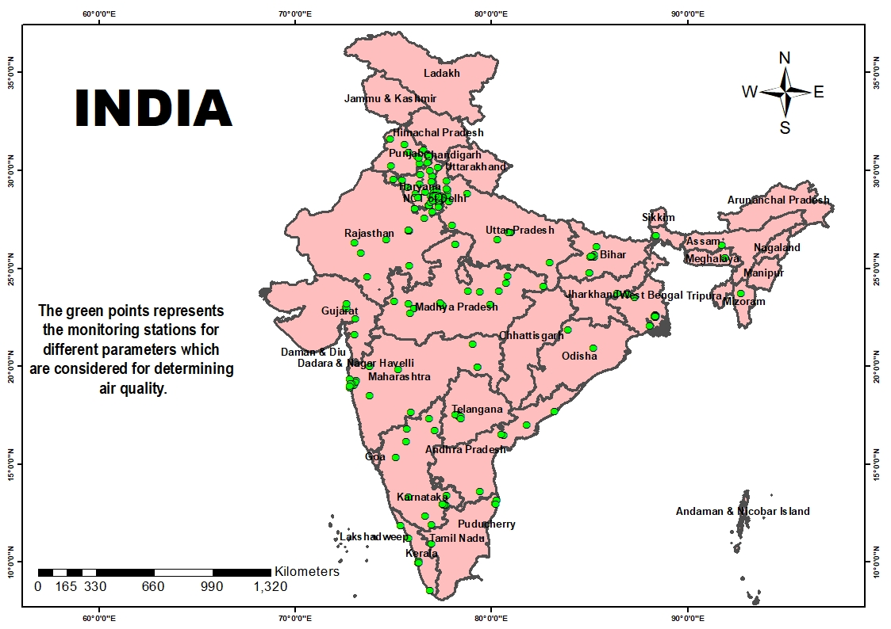
STUDY AREA

Slide 6
METHODOLOGY
231 monitoring station all over India
for 13 pollutant parameters
PM10, PM2.5,, CO, NO, NH3, Nox, NO2, O3, SO2
for the 3 periods, i.e, pre-lockdown, Lockdown and Unlock,
WD, WS , RH
BP- the basic health
Data collection for determining air quality of pre-, during and after lockdown
Calculation of an average for the 13 parameters that were considered for this study.
Dot density analysis for all 13 parameters for the three different periods.
Results and Conclusion

Slide 7
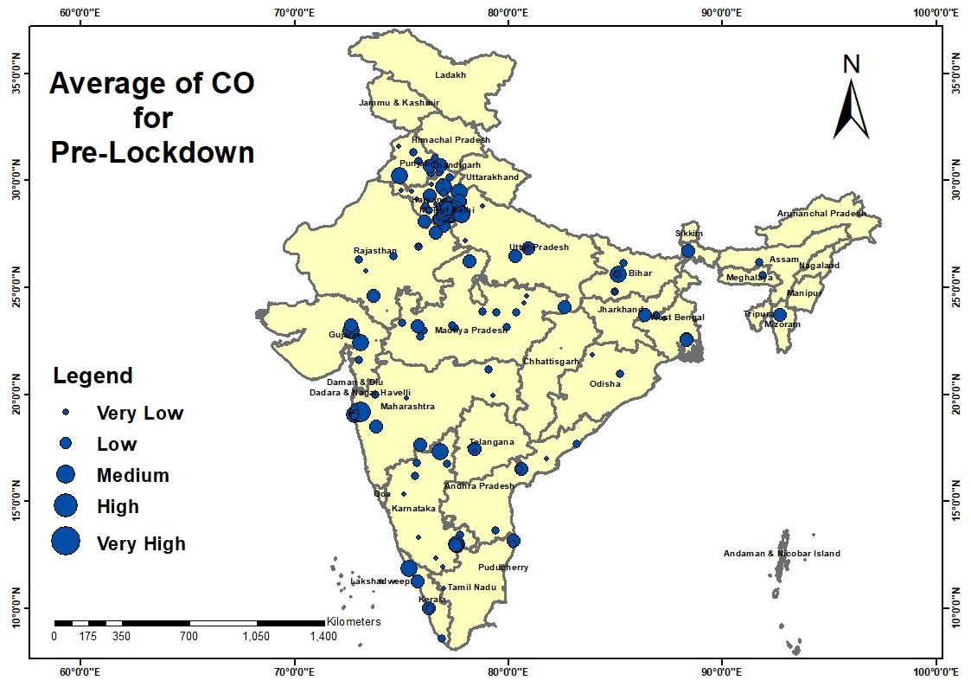
CARBON MONOXIDE levels pre-lockdown

Slide 8
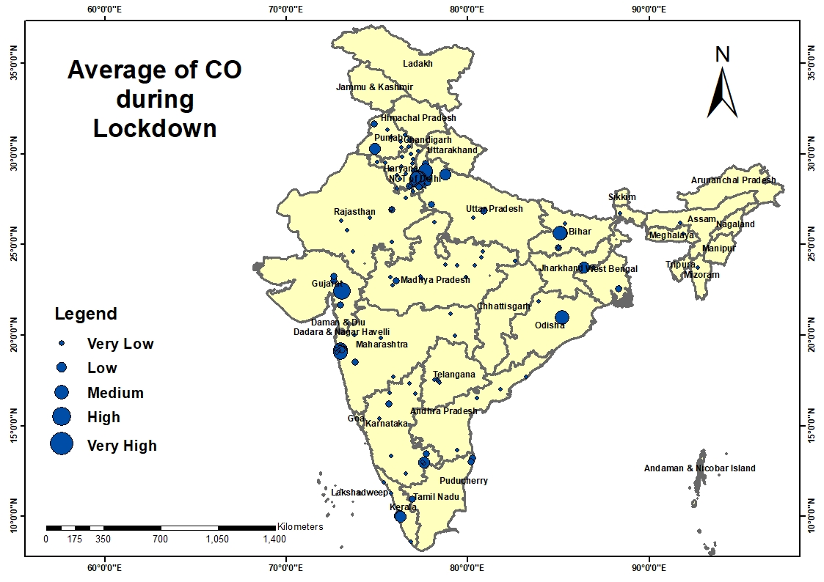
CARBON MONOXIDE levels during lockdown

Slide 9
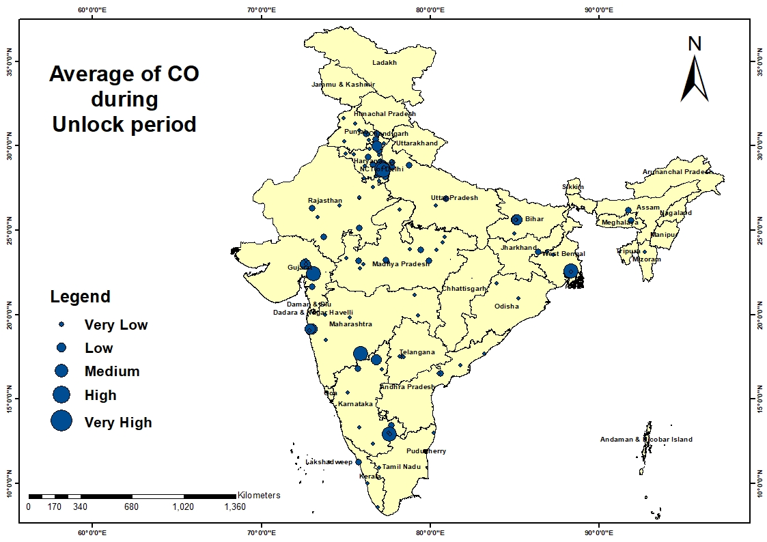
CARBON MONOXIDE levels during unlock

Slide 10
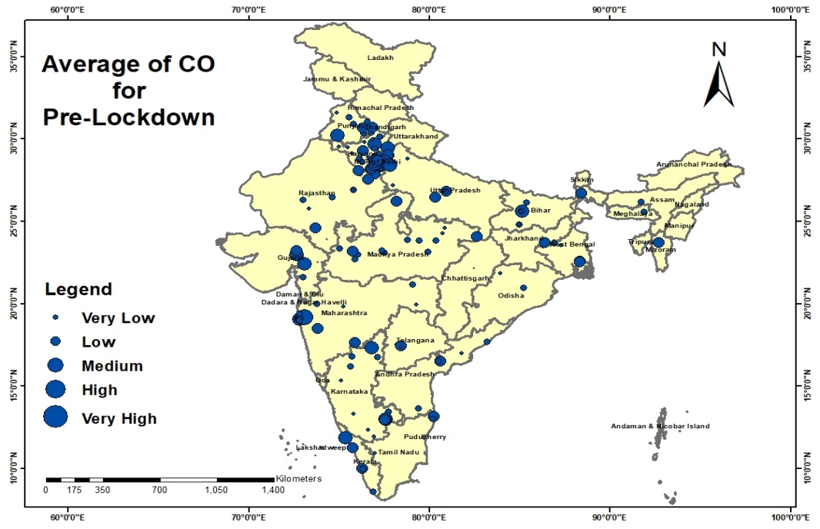
Average of CO

Slide 11
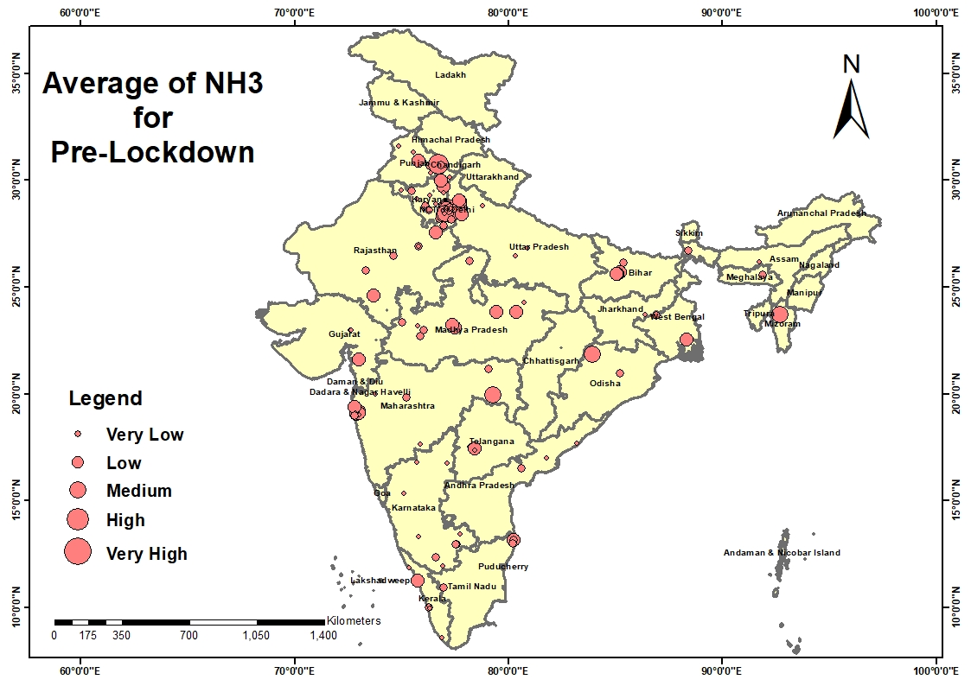
Levels of AMMONIA pre-lockdown

Slide 12
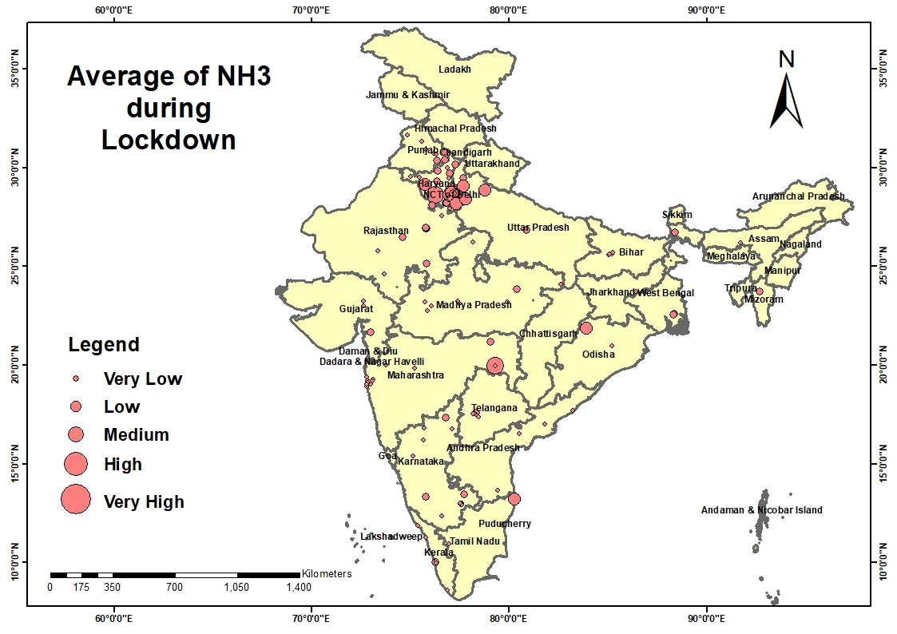
Levels of AMMONIA during lockdown

Slide 13
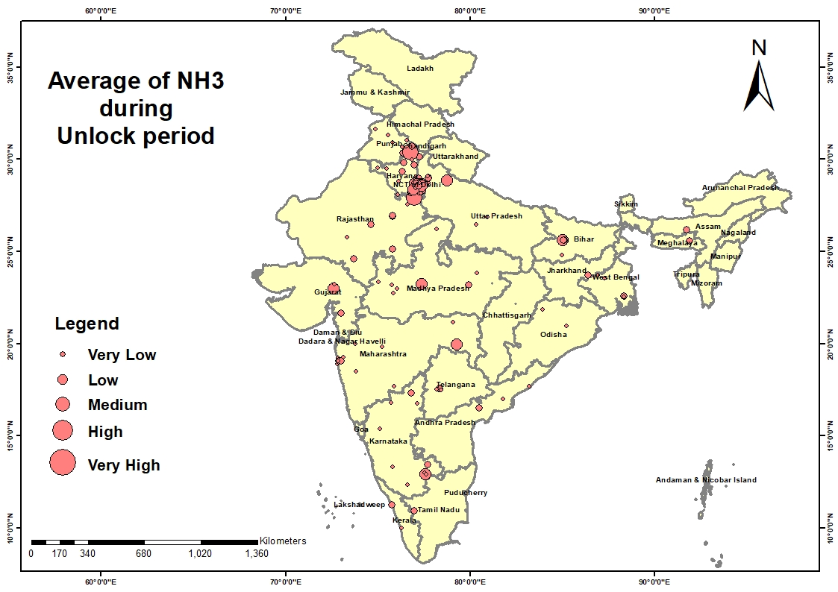
Levels of AMMONIA after unlock

Slide 14
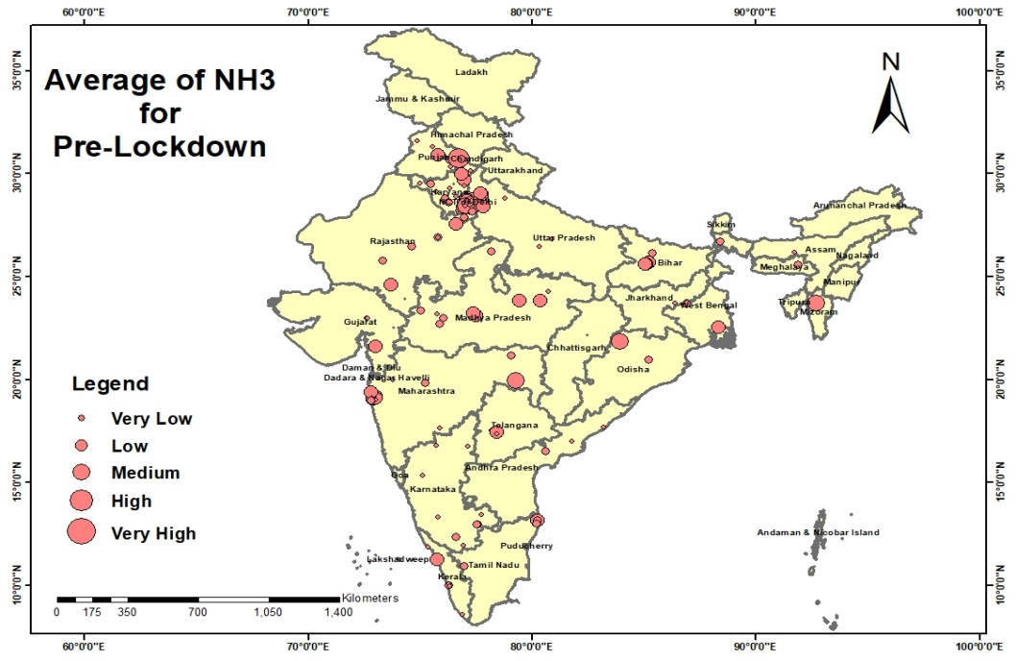
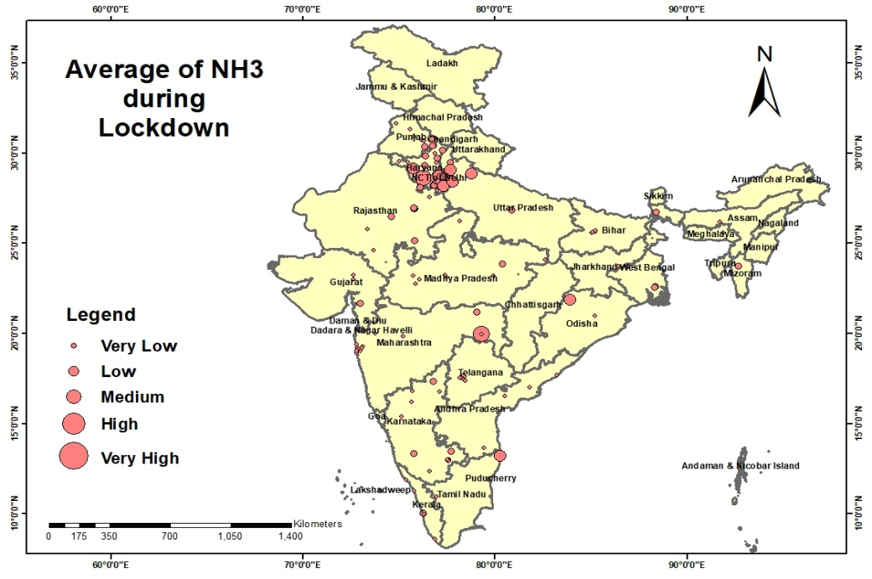
Average of NH3

Slide 15
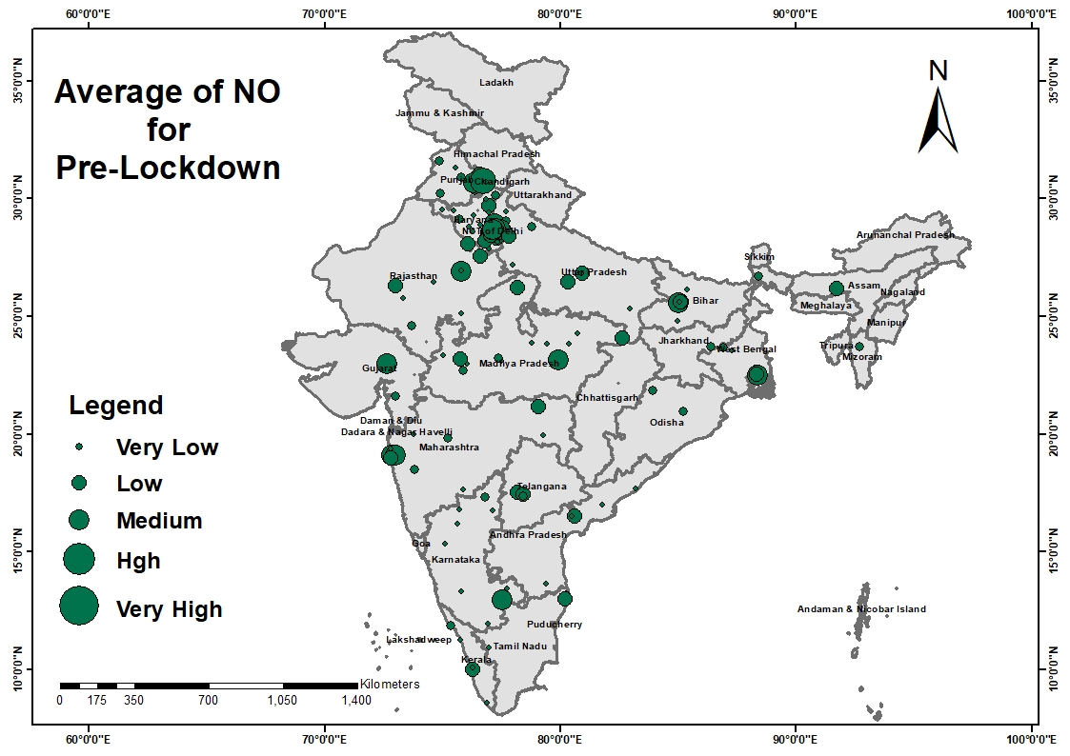
NITROGEN MONOXIDE levels pre-lockdown

Slide 16
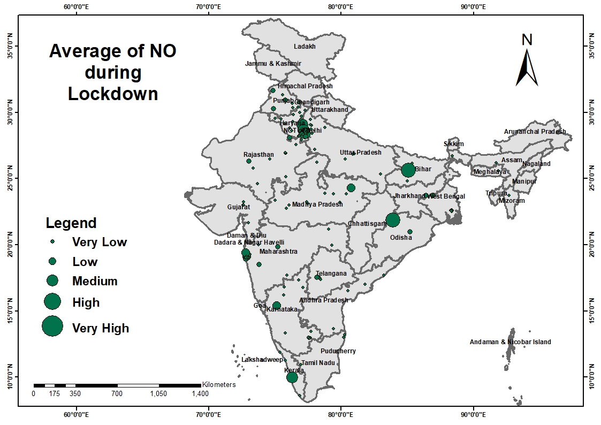
NITROGEN MONOXIDE levels during lockdown

Slide 17
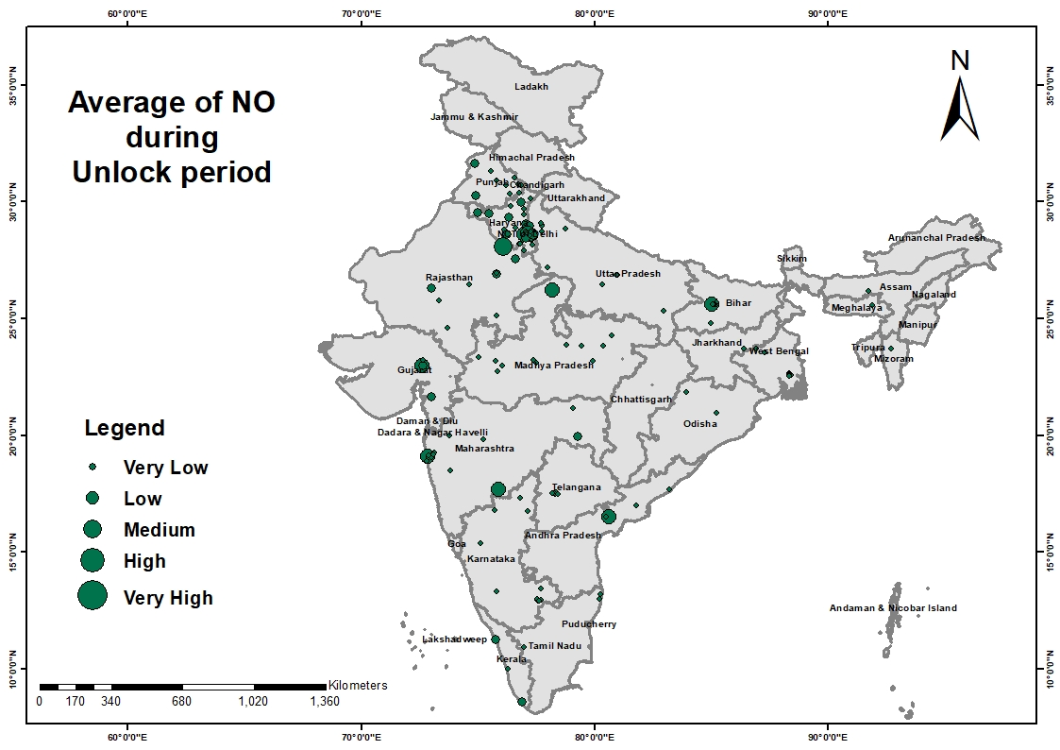
NITROGEN MONOXIDE levels after unlock

Slide 18
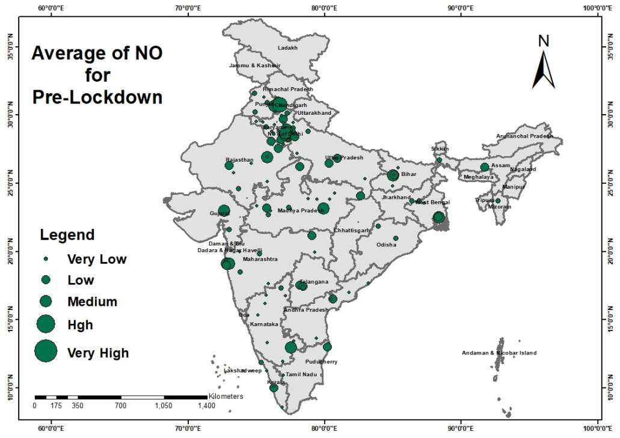
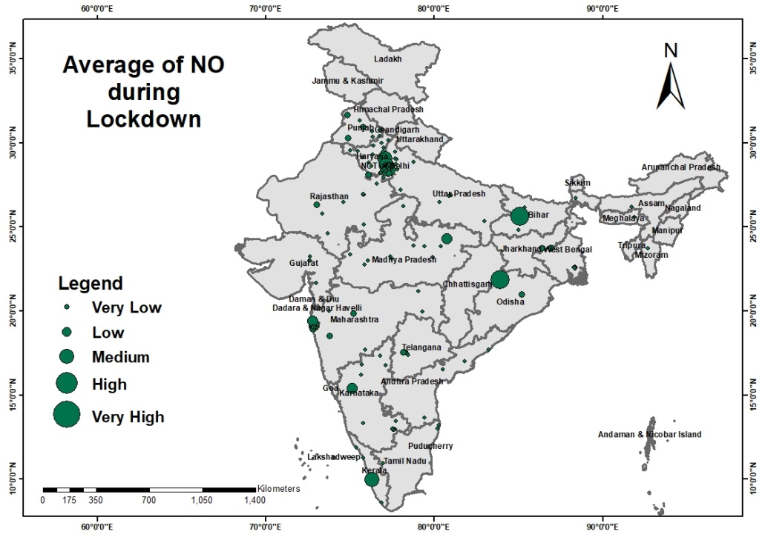
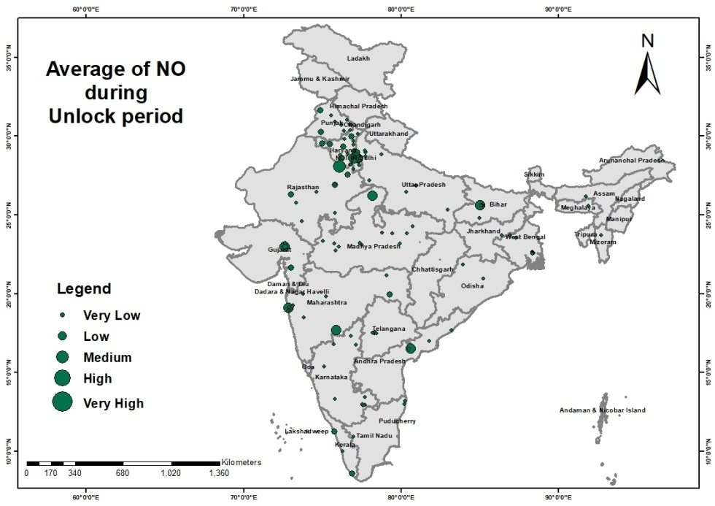
Average of NO

Slide 19
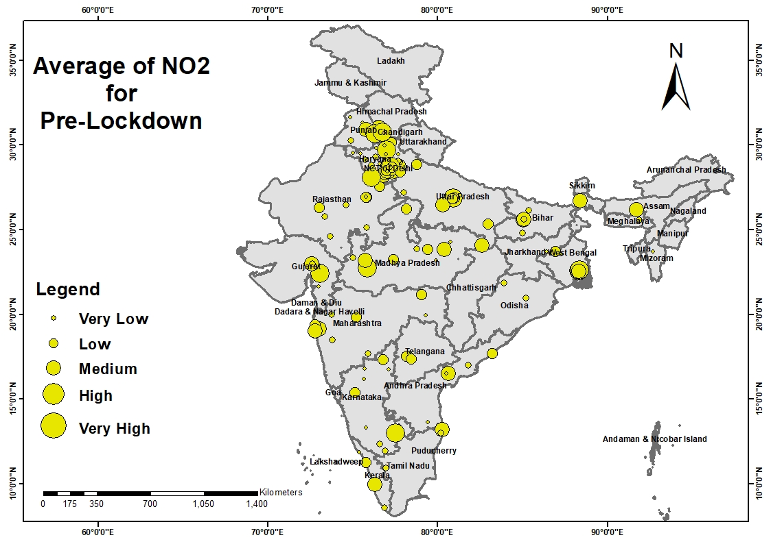
NITROGEN DIOXIDE levels pre-lockdown

Slide 20
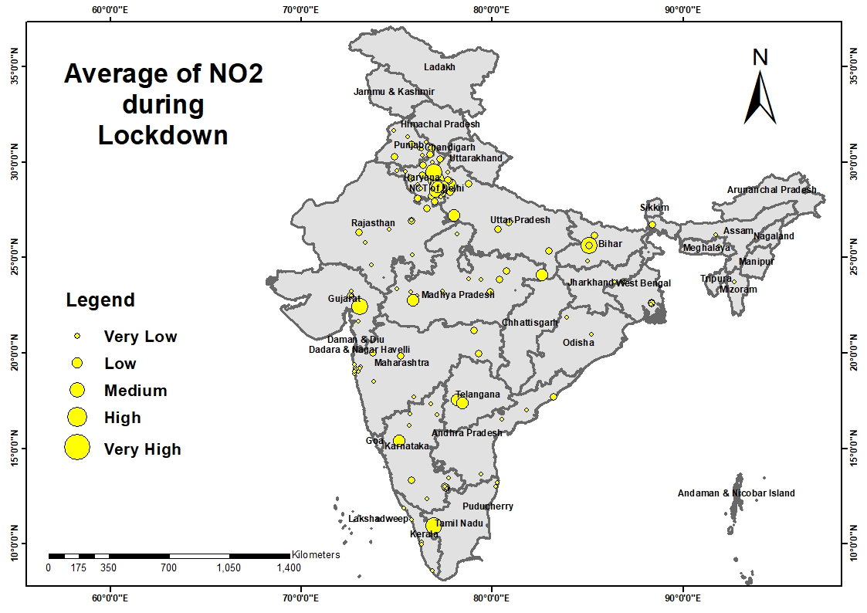
NITROGEN DIOXIDE levels during lockdown

Slide 21
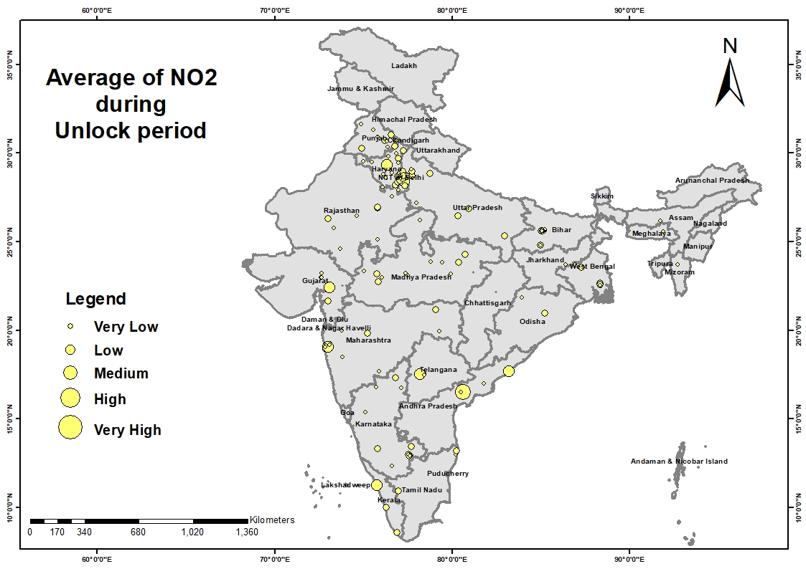
NITROGEN MONOXIDE levels after unlock

Slide 22
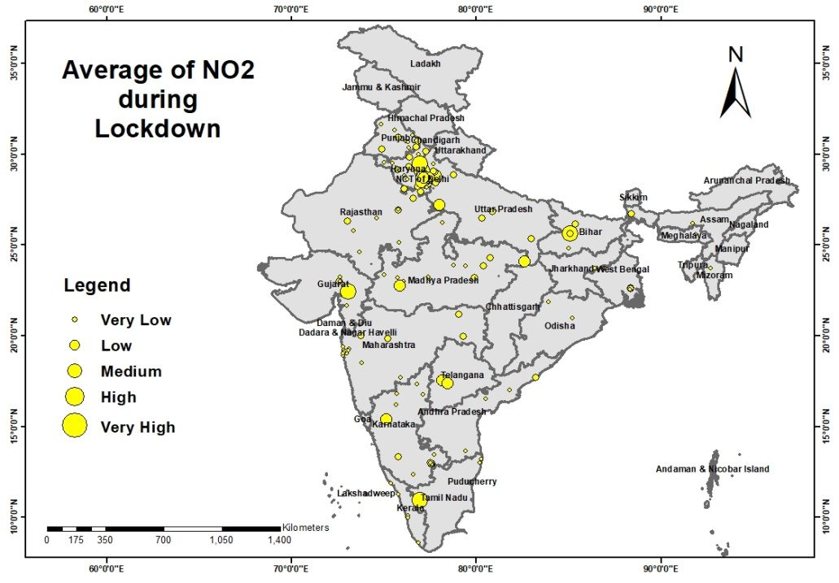
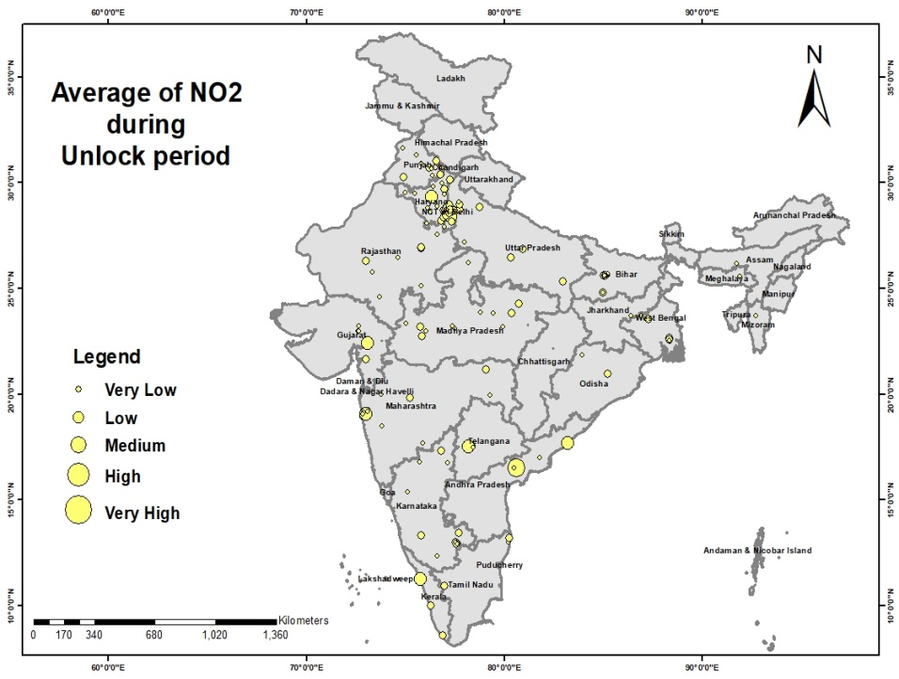
Average of NO2

Slide 23
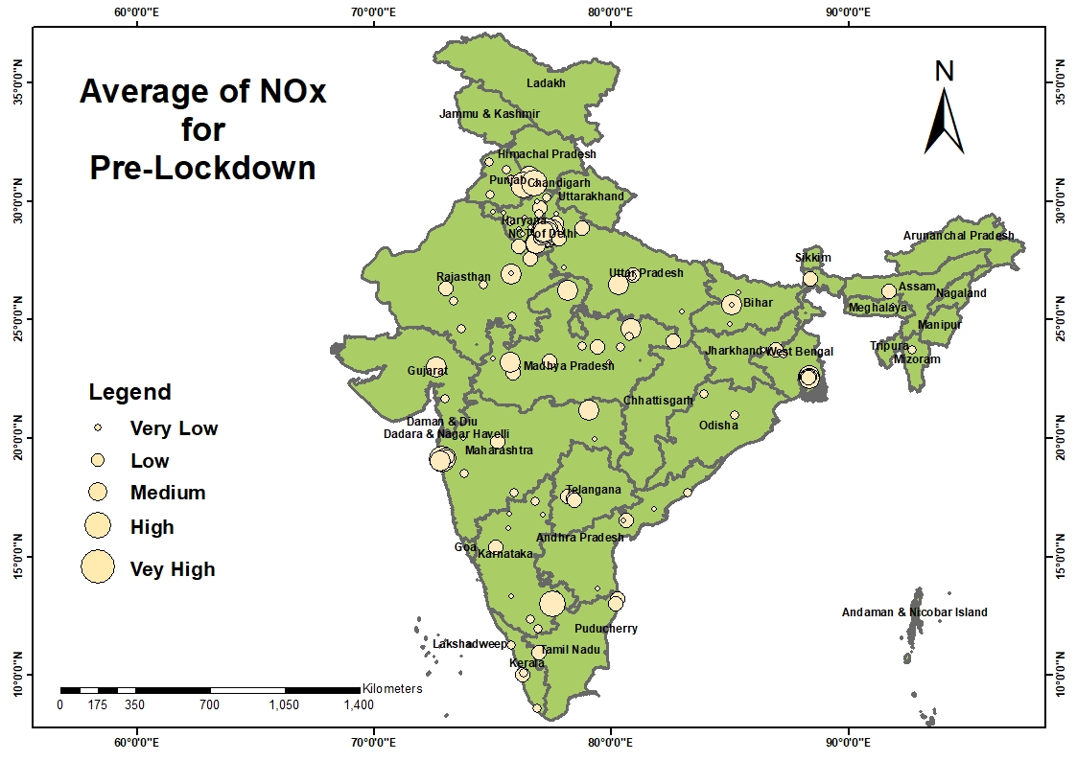
NITROGEN OXIDE levels pre-lockdown

Slide 24
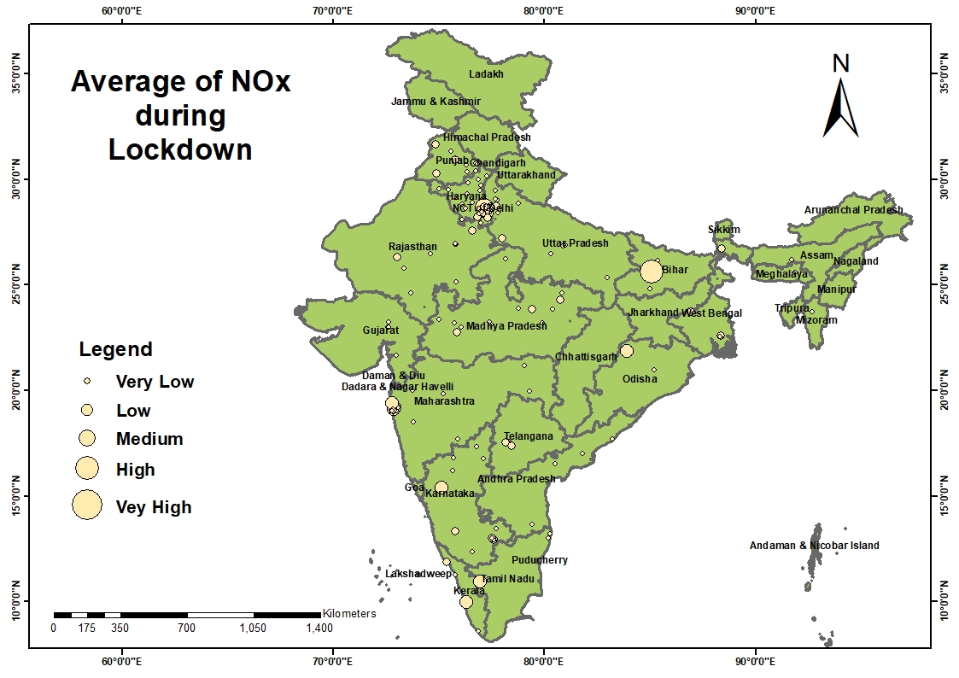
NITROGEN OXIDE levels during lockdown

Slide 25
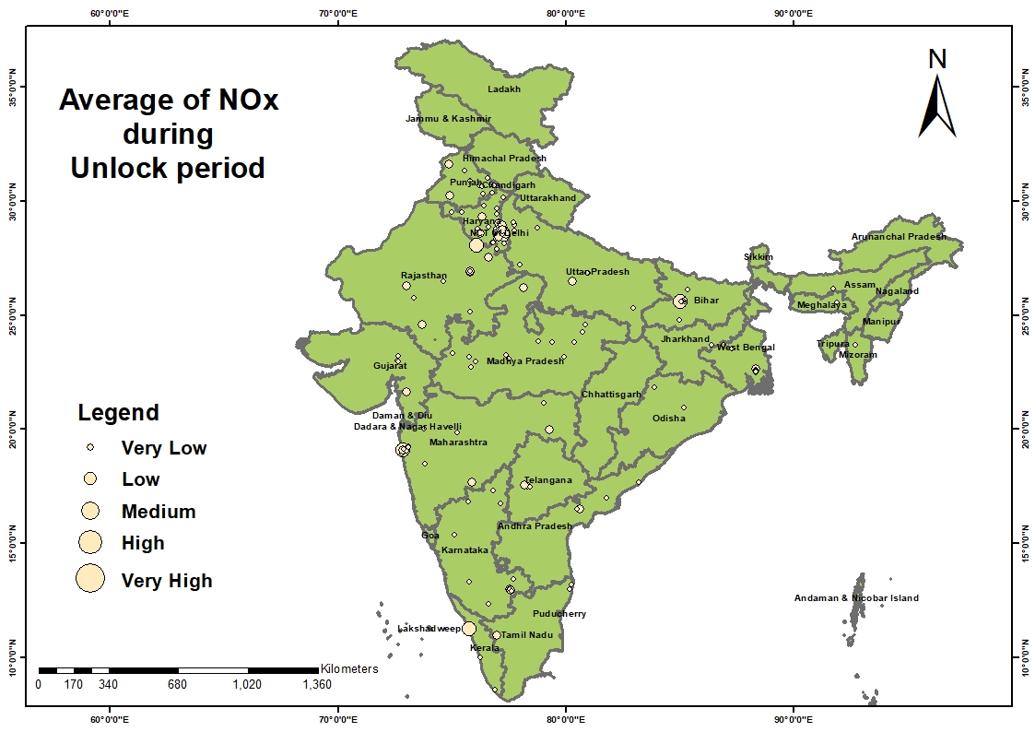
NITROGEN OXIDE levels after unlock

Slide 26
Average of NOx

Slide 27
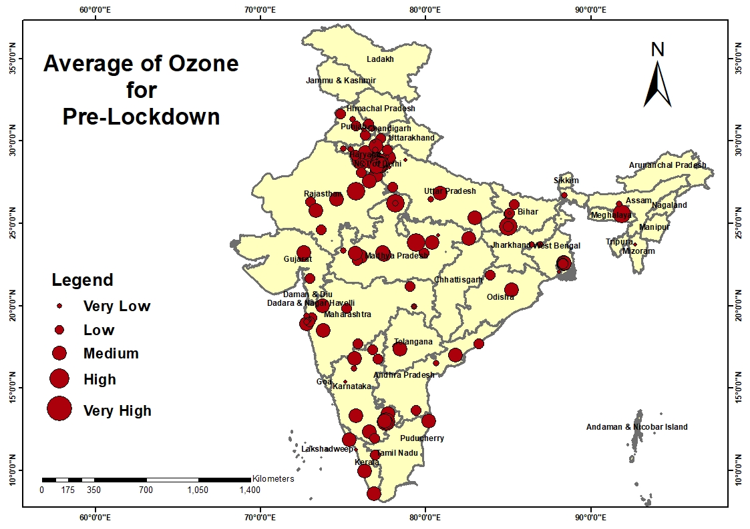
OZONE levels pre-lockdown

Slide 28
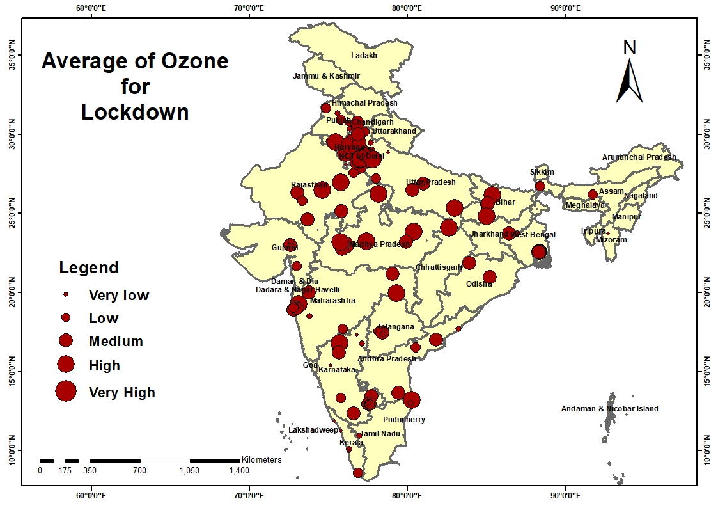
OZONE levels during lockdown

Slide 29
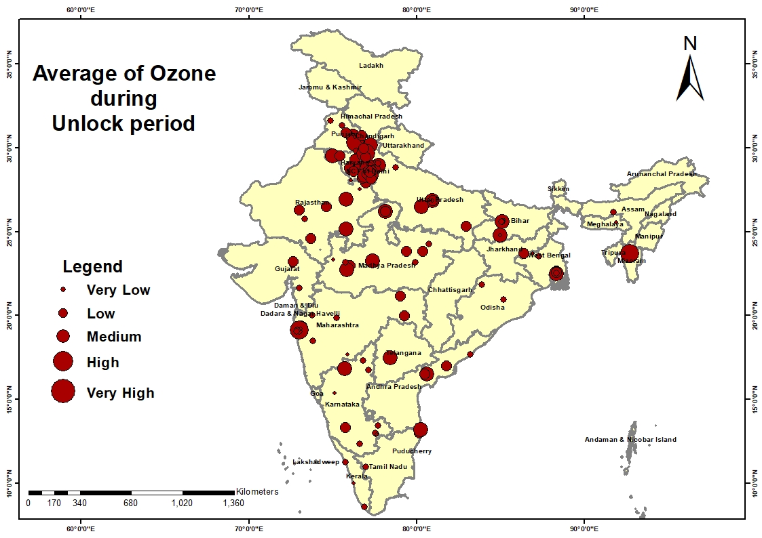
Ozone levels after unlock

Slide 30
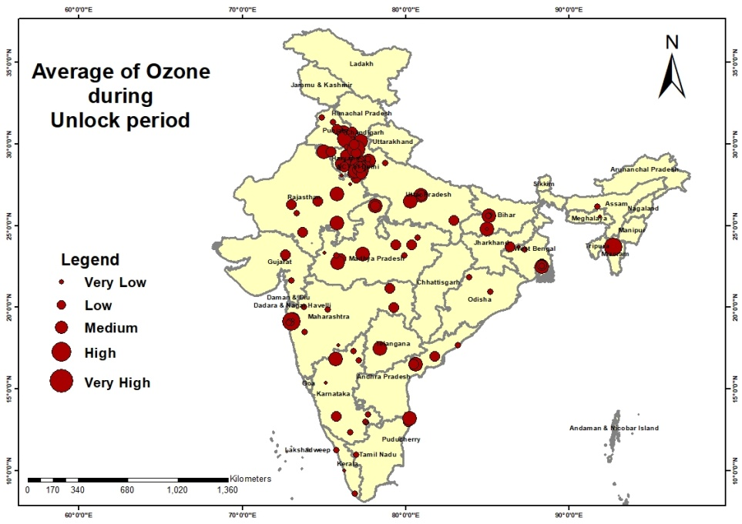
Average of O3

Slide 31
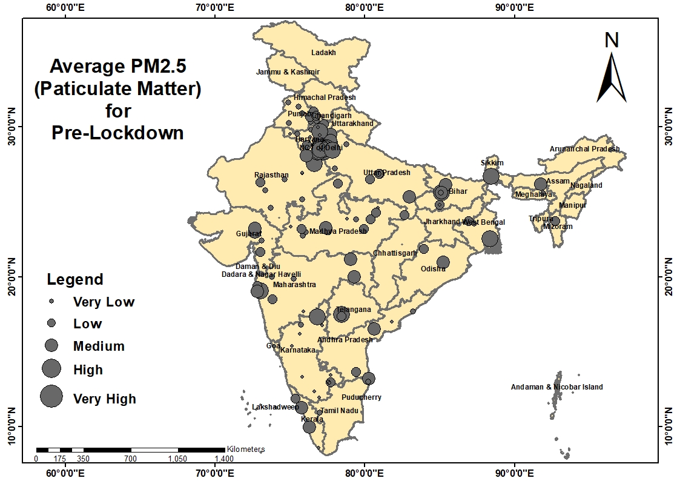
FINE PARTICULATE MATTER levels pre-lockdown

Slide 32
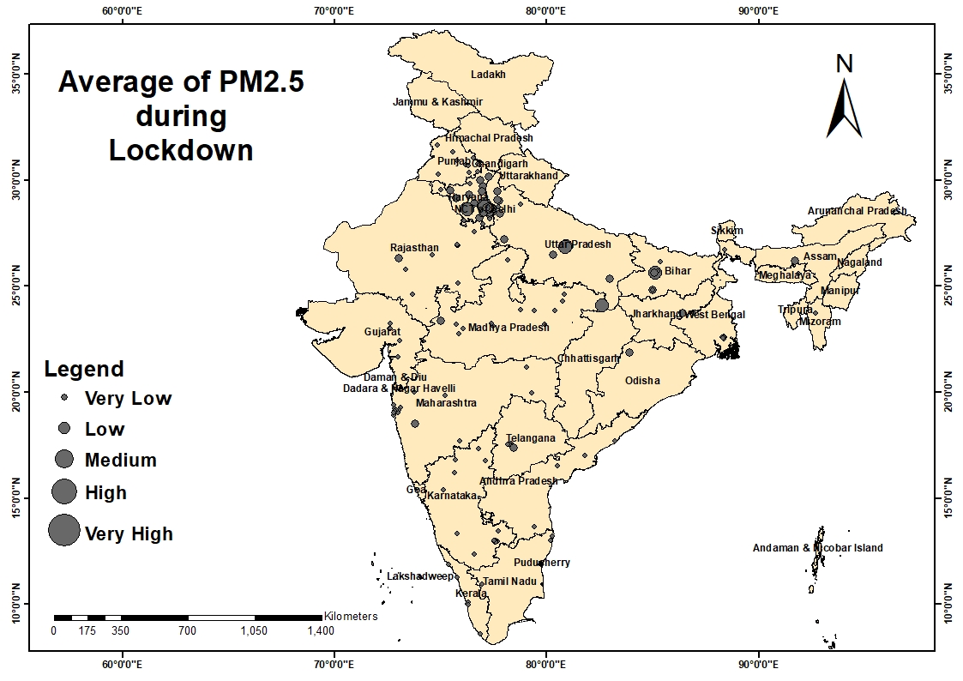
FINE PARTICULATE MATTER levels during lockdown

Slide 33
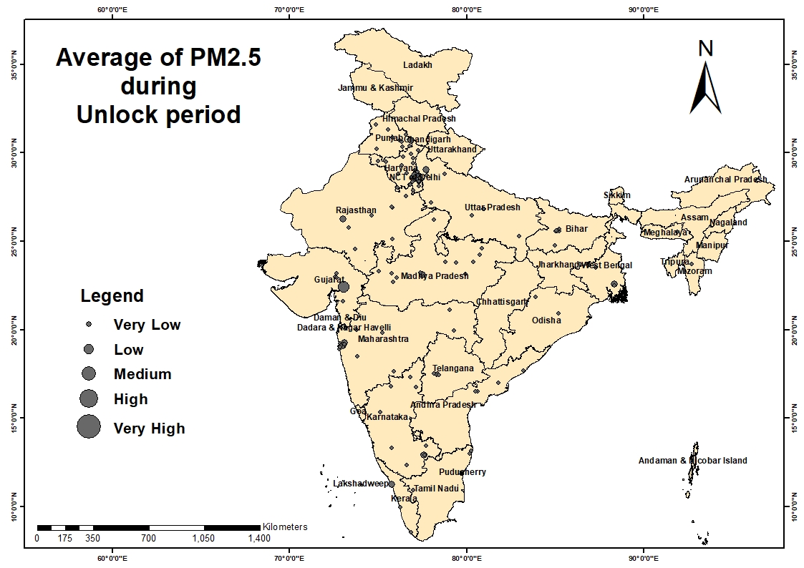
FINE PARTICULATE MATTER levels after unlock

Slide 34
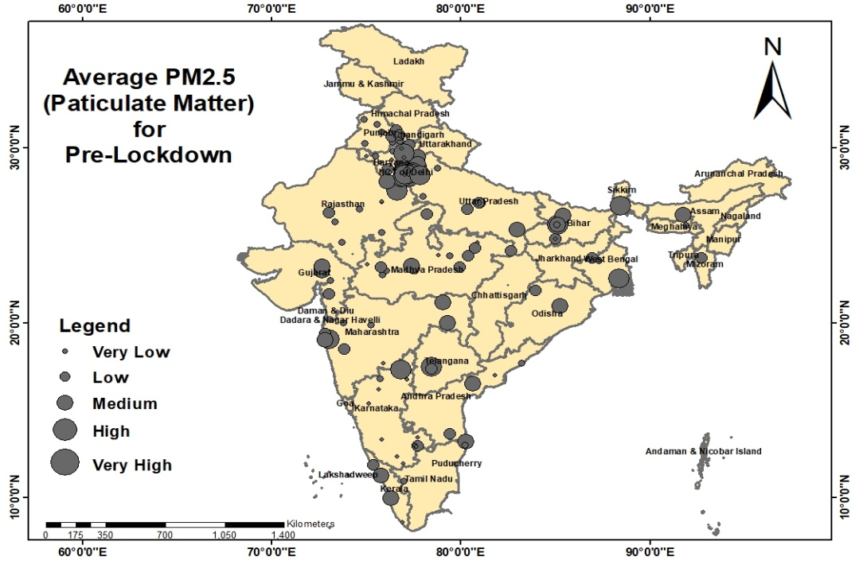
Average of PM2.5

Slide 35
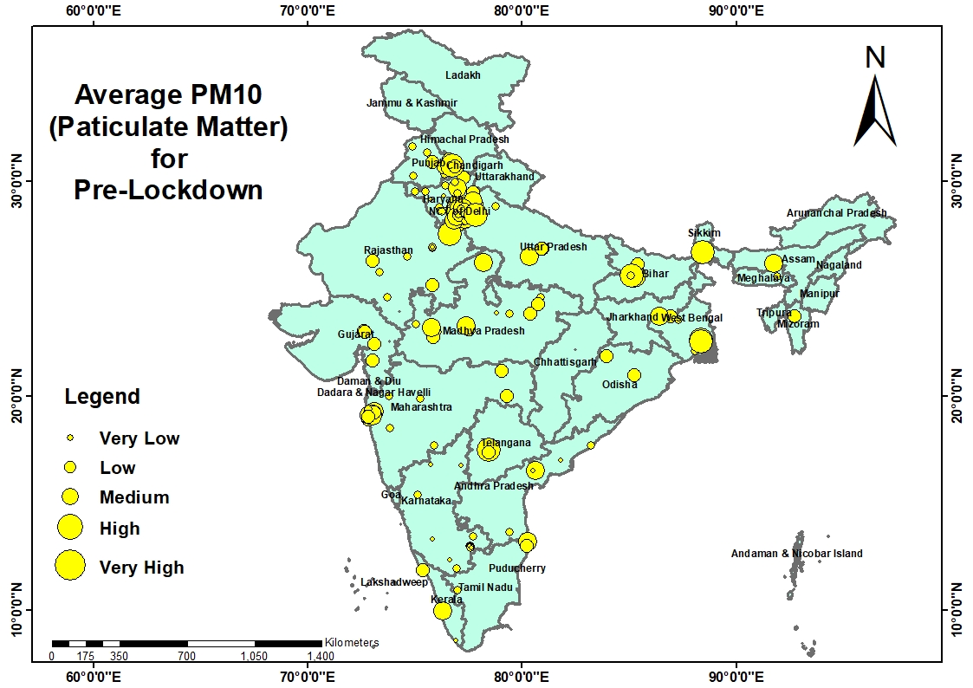
PARTICULATE MATTER levels pre-lockdown

Slide 36
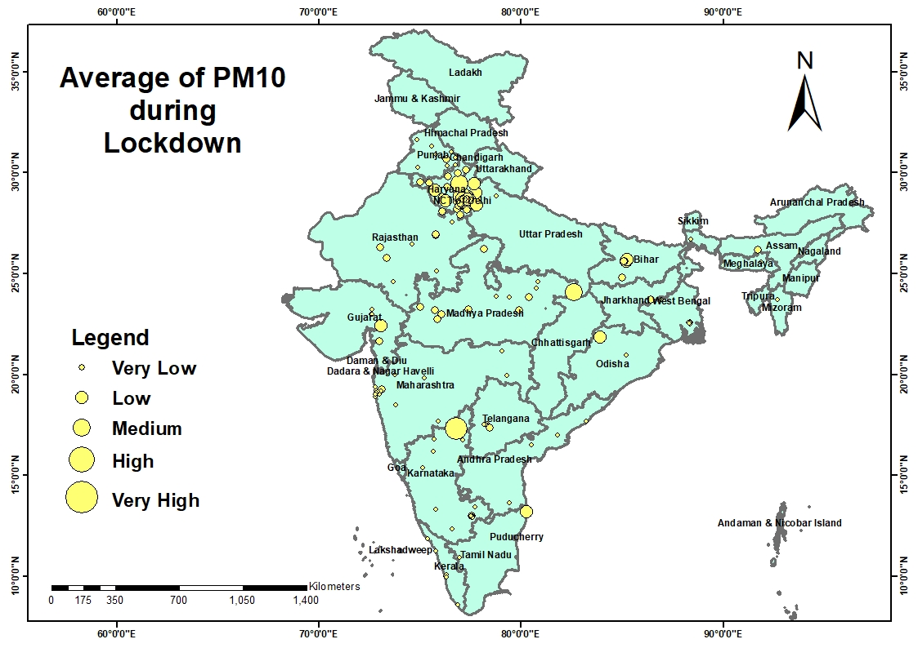
PARTICULATE MATTER levels during lockdown

Slide 37
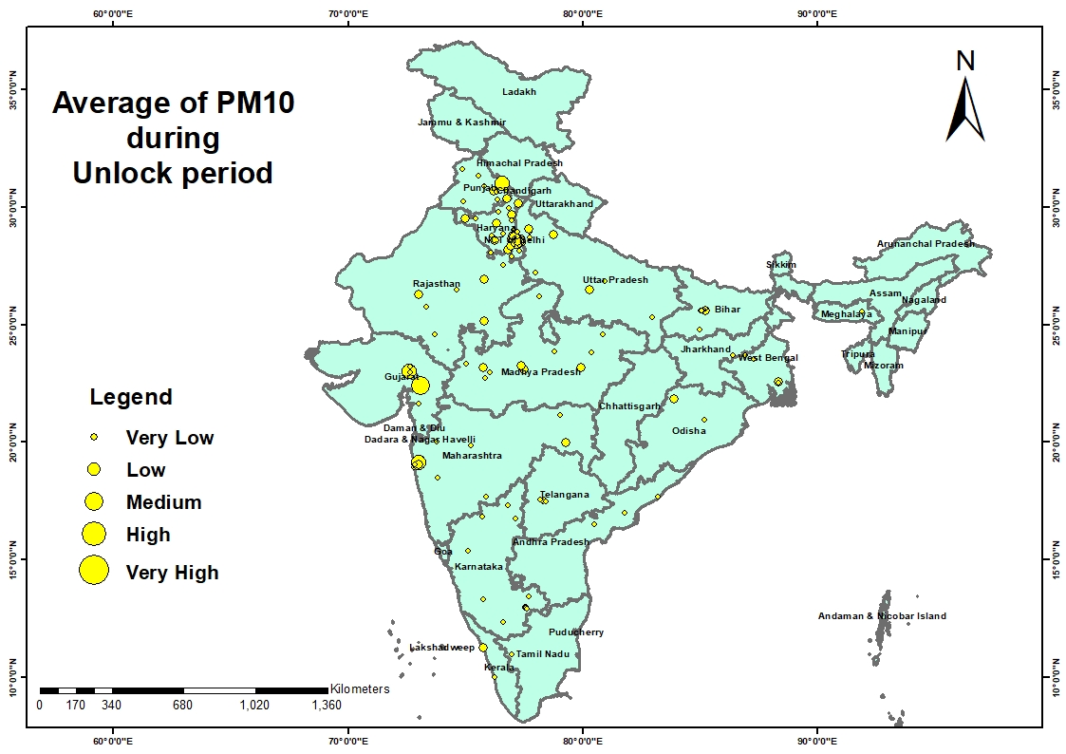
PARTICULATE MATTER levels after unlock

Slide 38
Average of PM10

Slide 39
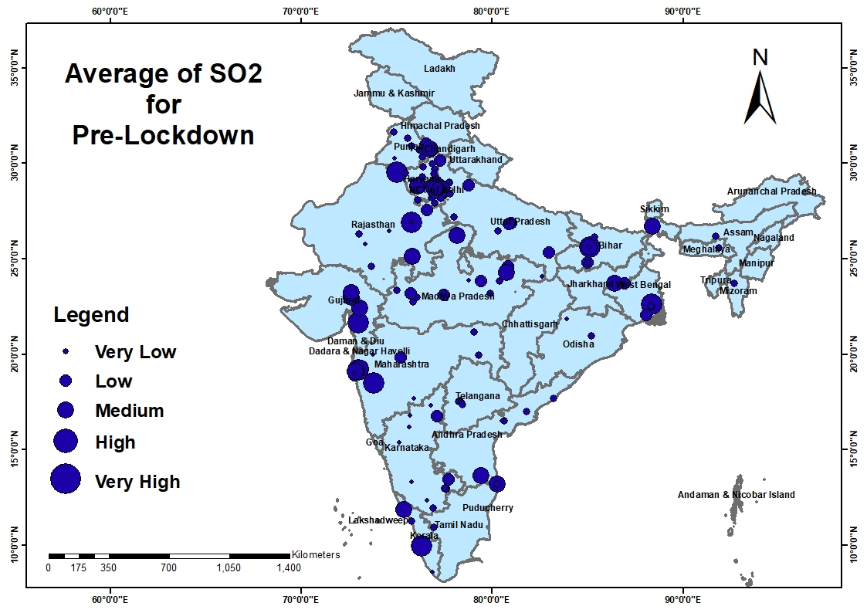
Sufur dioxide levels pre-lockdown

Slide 40
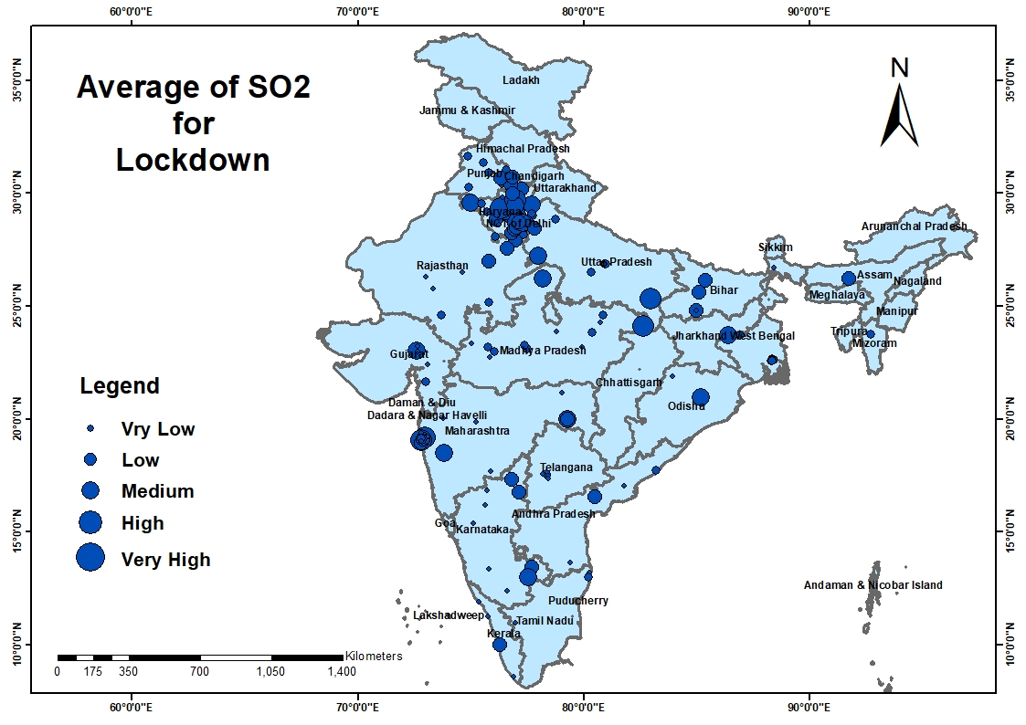
Sufur dioxide levels during lockdown

Slide 41
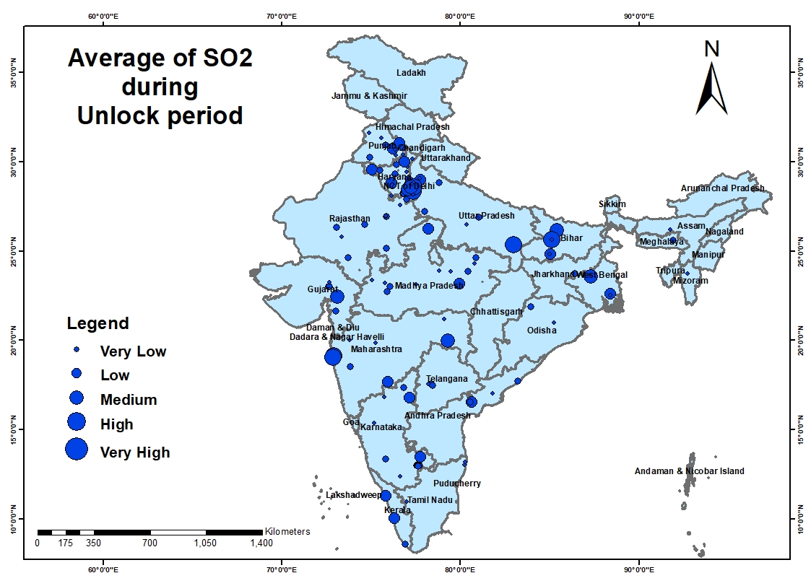
Sufur dioxide levels after unlock

Slide 42
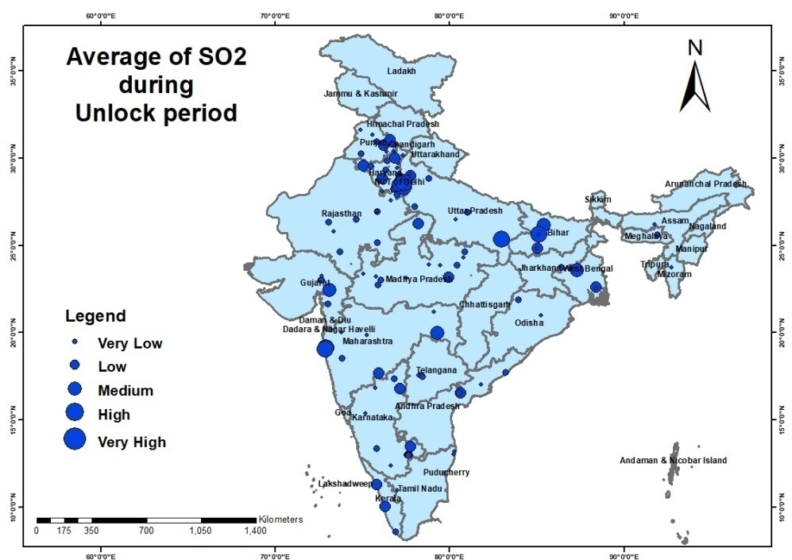
Average of SO2

Slide 43
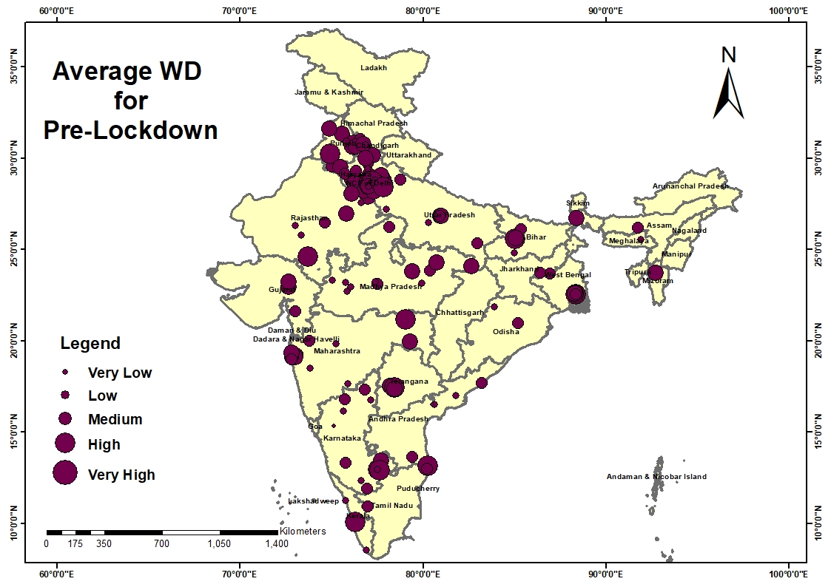
WIND DIRECTION pre-lockdown

Slide 44
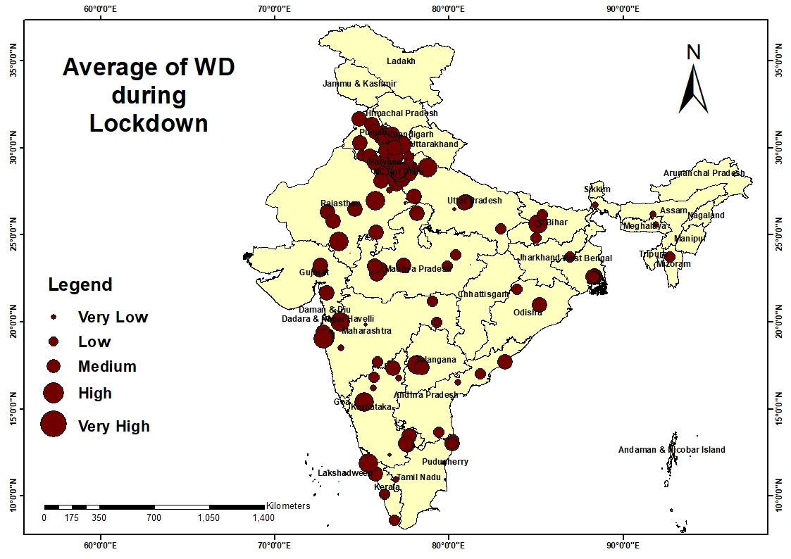
WIND DIRECTION during lockdown

Slide 45
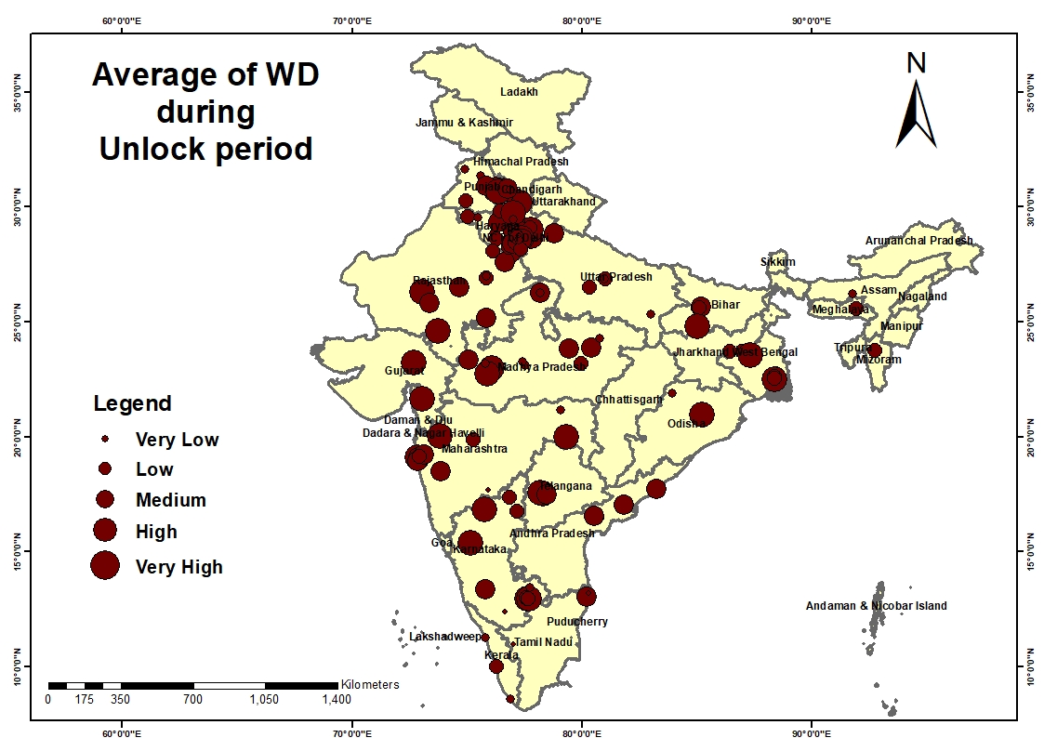
WIND DIRECTION after unlock

Slide 46
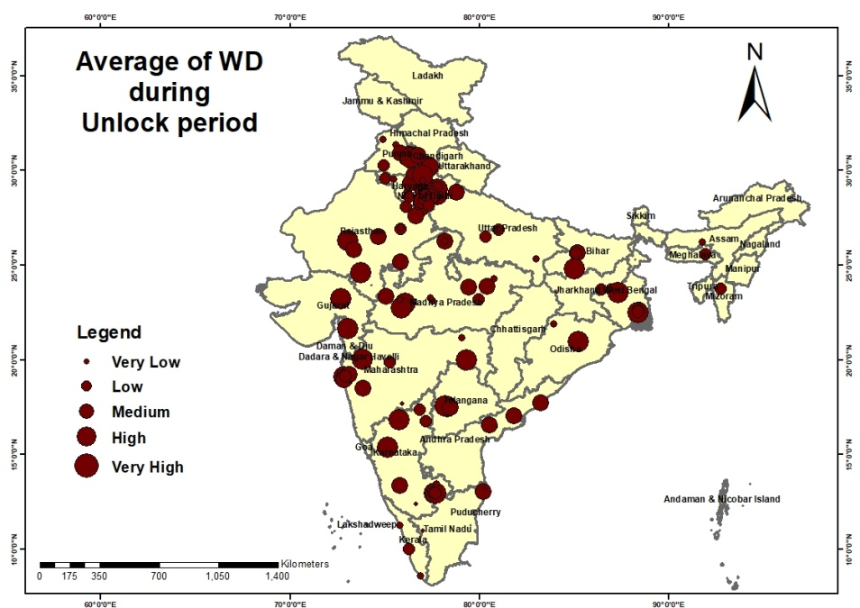
Average of WD

Slide 47
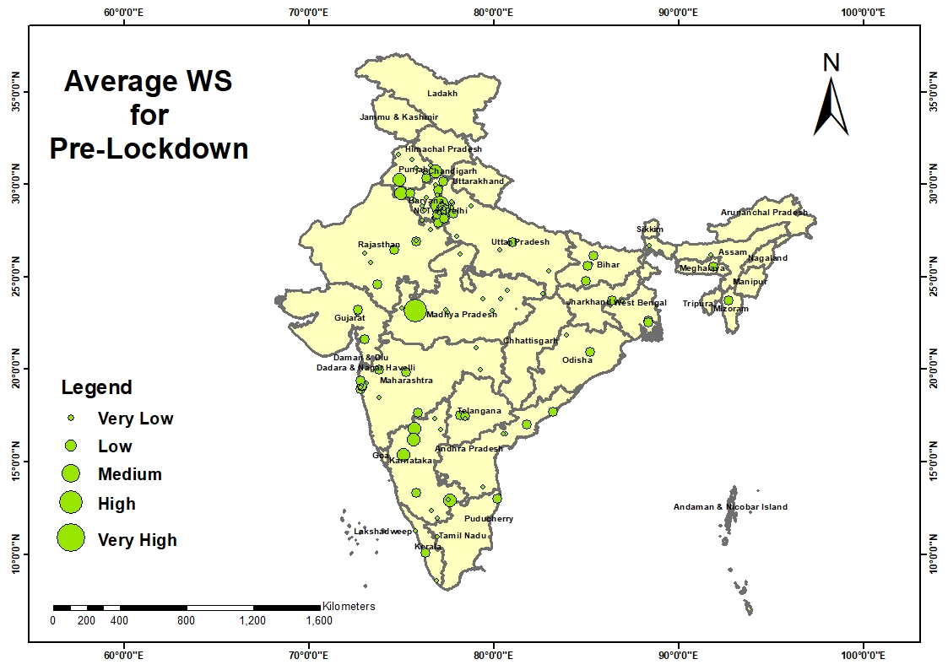
WIND SPEED pre-lockdown

Slide 48
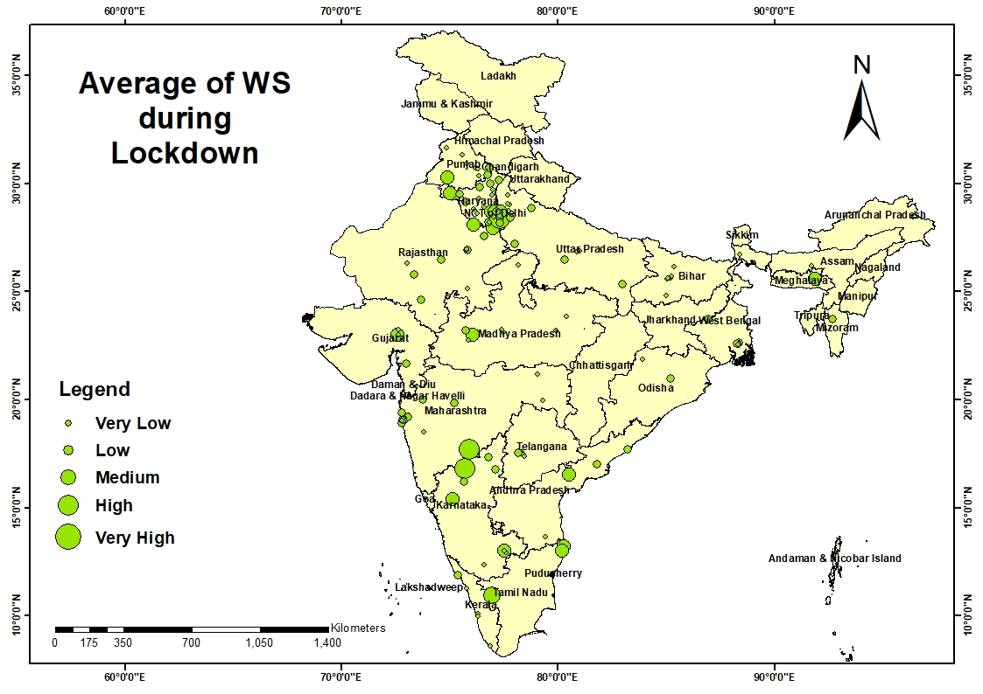
WIND SPEED during lockdown

Slide 49
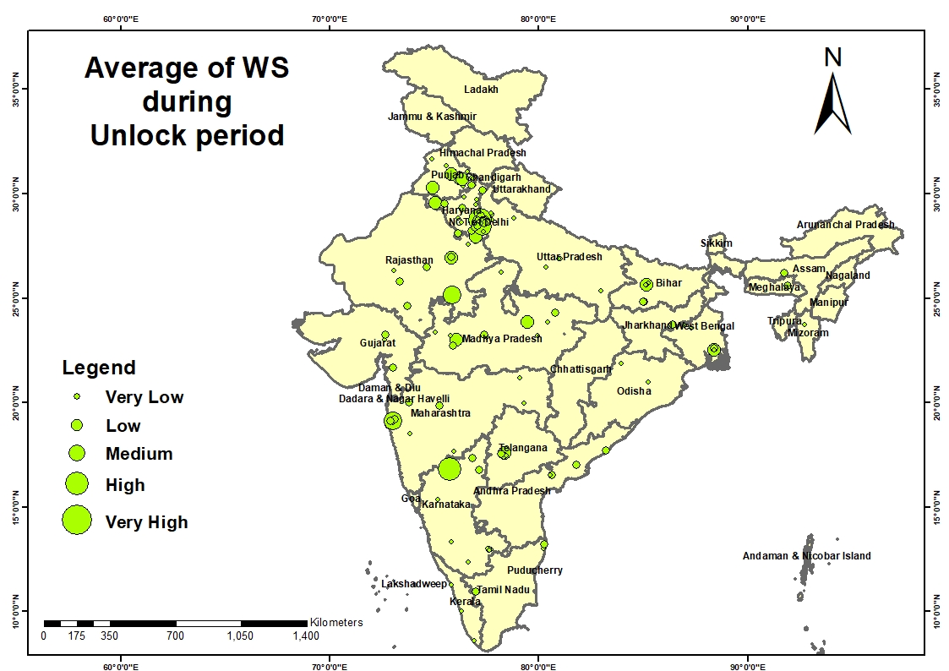
WIND SPEED after unlock

Slide 50
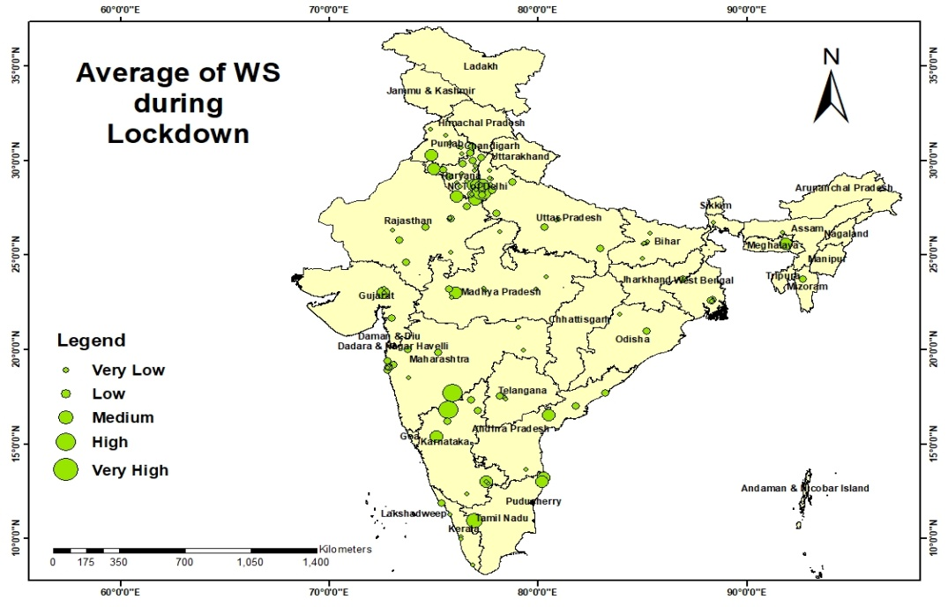
Average of WS

Slide 51
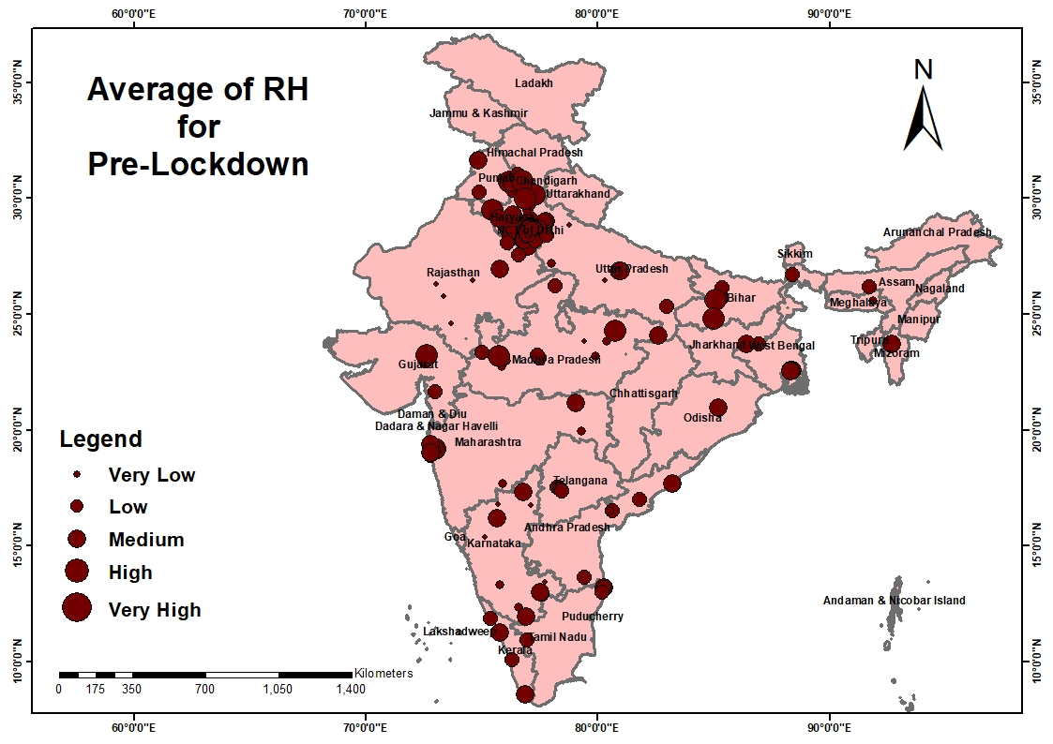
RELATIVE HUMIDITY pre-lockdown

Slide 52
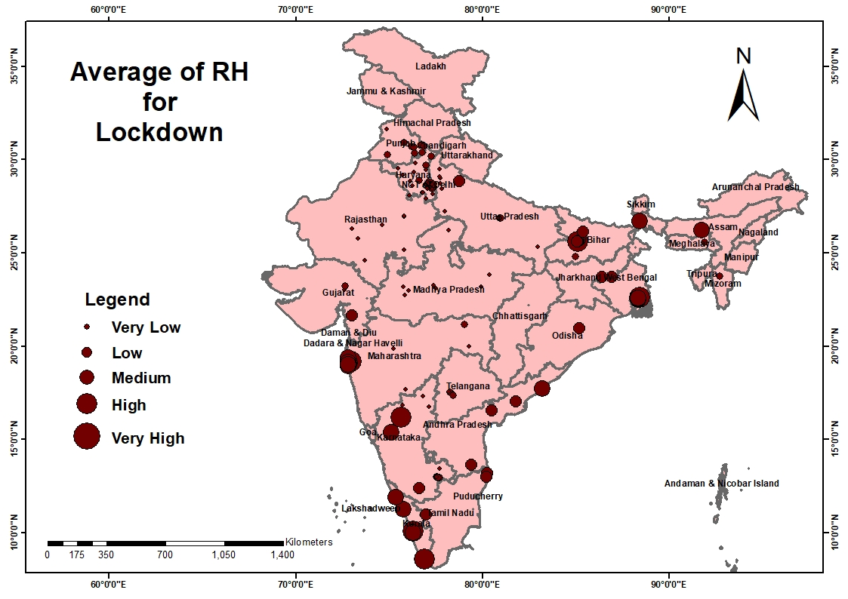
RELATIVE HUMIDITY during lockdown

Slide 53
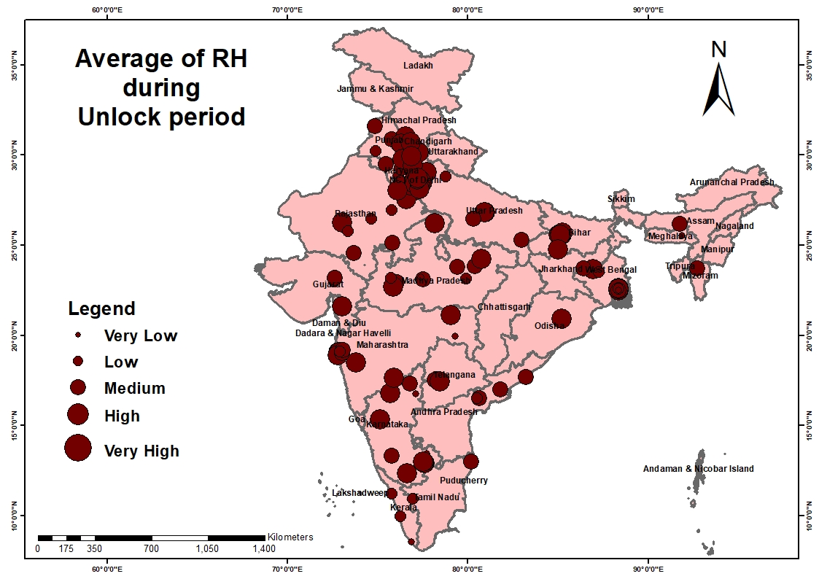
RELATIVE HUMIDITY after unlock

Slide 54
Average of RH

Slide 55
BLOOD PRESSURE levels pre-lockdown

Slide 56
BLOOD PRESSURE levels during lockdown

Slide 57
BLOOD PRESSURE levels after unlock

Slide 58
Average of BP

Slide 59
Results
The results for this study demonstrated that the decrease in the levels of CO, NH3, NO, NO2, NOx, O3, PM2.5, PM10, SO2 during the lockdown period compared to the pre-lockdown period clearly affirms the fact that the air quality has significantly improved due to mandatory guidelines of the lockdown pandemic.
Also, from the data collected for the unlock period starting from June to August, it could be understood that the air quality has become poorer again.
The levels of the pollutants increased in air as soon as the lockdown was lifted and day-to-day life started.

Slide 60
CONCLUSION
This study will help in realizing the drastic difference in the air quality before, during and after the lockdown.
It emphasizes on the importance of temporary lockdown of human affairs in the future, for suitable time intervals, and how that will help to mend the environment.
Temporary lockdowns, thus might be an effective alternate measure to be implemented in the future for improving air quality and controlling pollution.

Slide 61
THANK YOU
WEAR MASK AND STAY SAFE!

