Slide 2
GEOSPATIAL DEMARCATION OF CRIME AGAINST WOMEN IN INDIAN CONTEXT
Hotspots
Under Arrest
Introduction
Conclusion
Rape
Bar Chart
Murder
Crimes
RUBINI.M.R, SALGHUNA.NN
DEPARTMENT OF REMOTE SENSING
BHARATHIDASAN UNIVERSITY
TRICHY
INDIA
About

Slide 3
The "Crimes in India -2019" report shows that crimes against women have gone up by 7.3 per cent last year.
The crime rate registered per lakh women population is 62.4 per cent in 2019, up from the 58.8 per cent figure of 2018.
The country had recorded 3,78,236 cases of crimes against women in 2018, data shows.
India recorded an average 87 rape cases every day in 2019 and 4,05,861 cases of crimes against women during the year -- a rise of over seven per cent from 2018 -- shows latest data released by the National Crime Records Bureau
There is a gradual increase in crime rate against women in India. The use of GIS tools has greatly facilitated and enhanced the creation of crime maps, which visually pinpoint reported unlawful activities and help analysts detect spatial and temporal crime patterns and trends.
Hotspots
Under Arrest
Introduction
Conclusion
Rape
Bar Chart
Murder
Crimes
About

Slide 4
RAPE
MURDER
UNDER ARREST
Hotspots
Under Arrest
Introduction
Conclusion
Rape
Bar Chart
Murder
Crimes
About

Slide 5
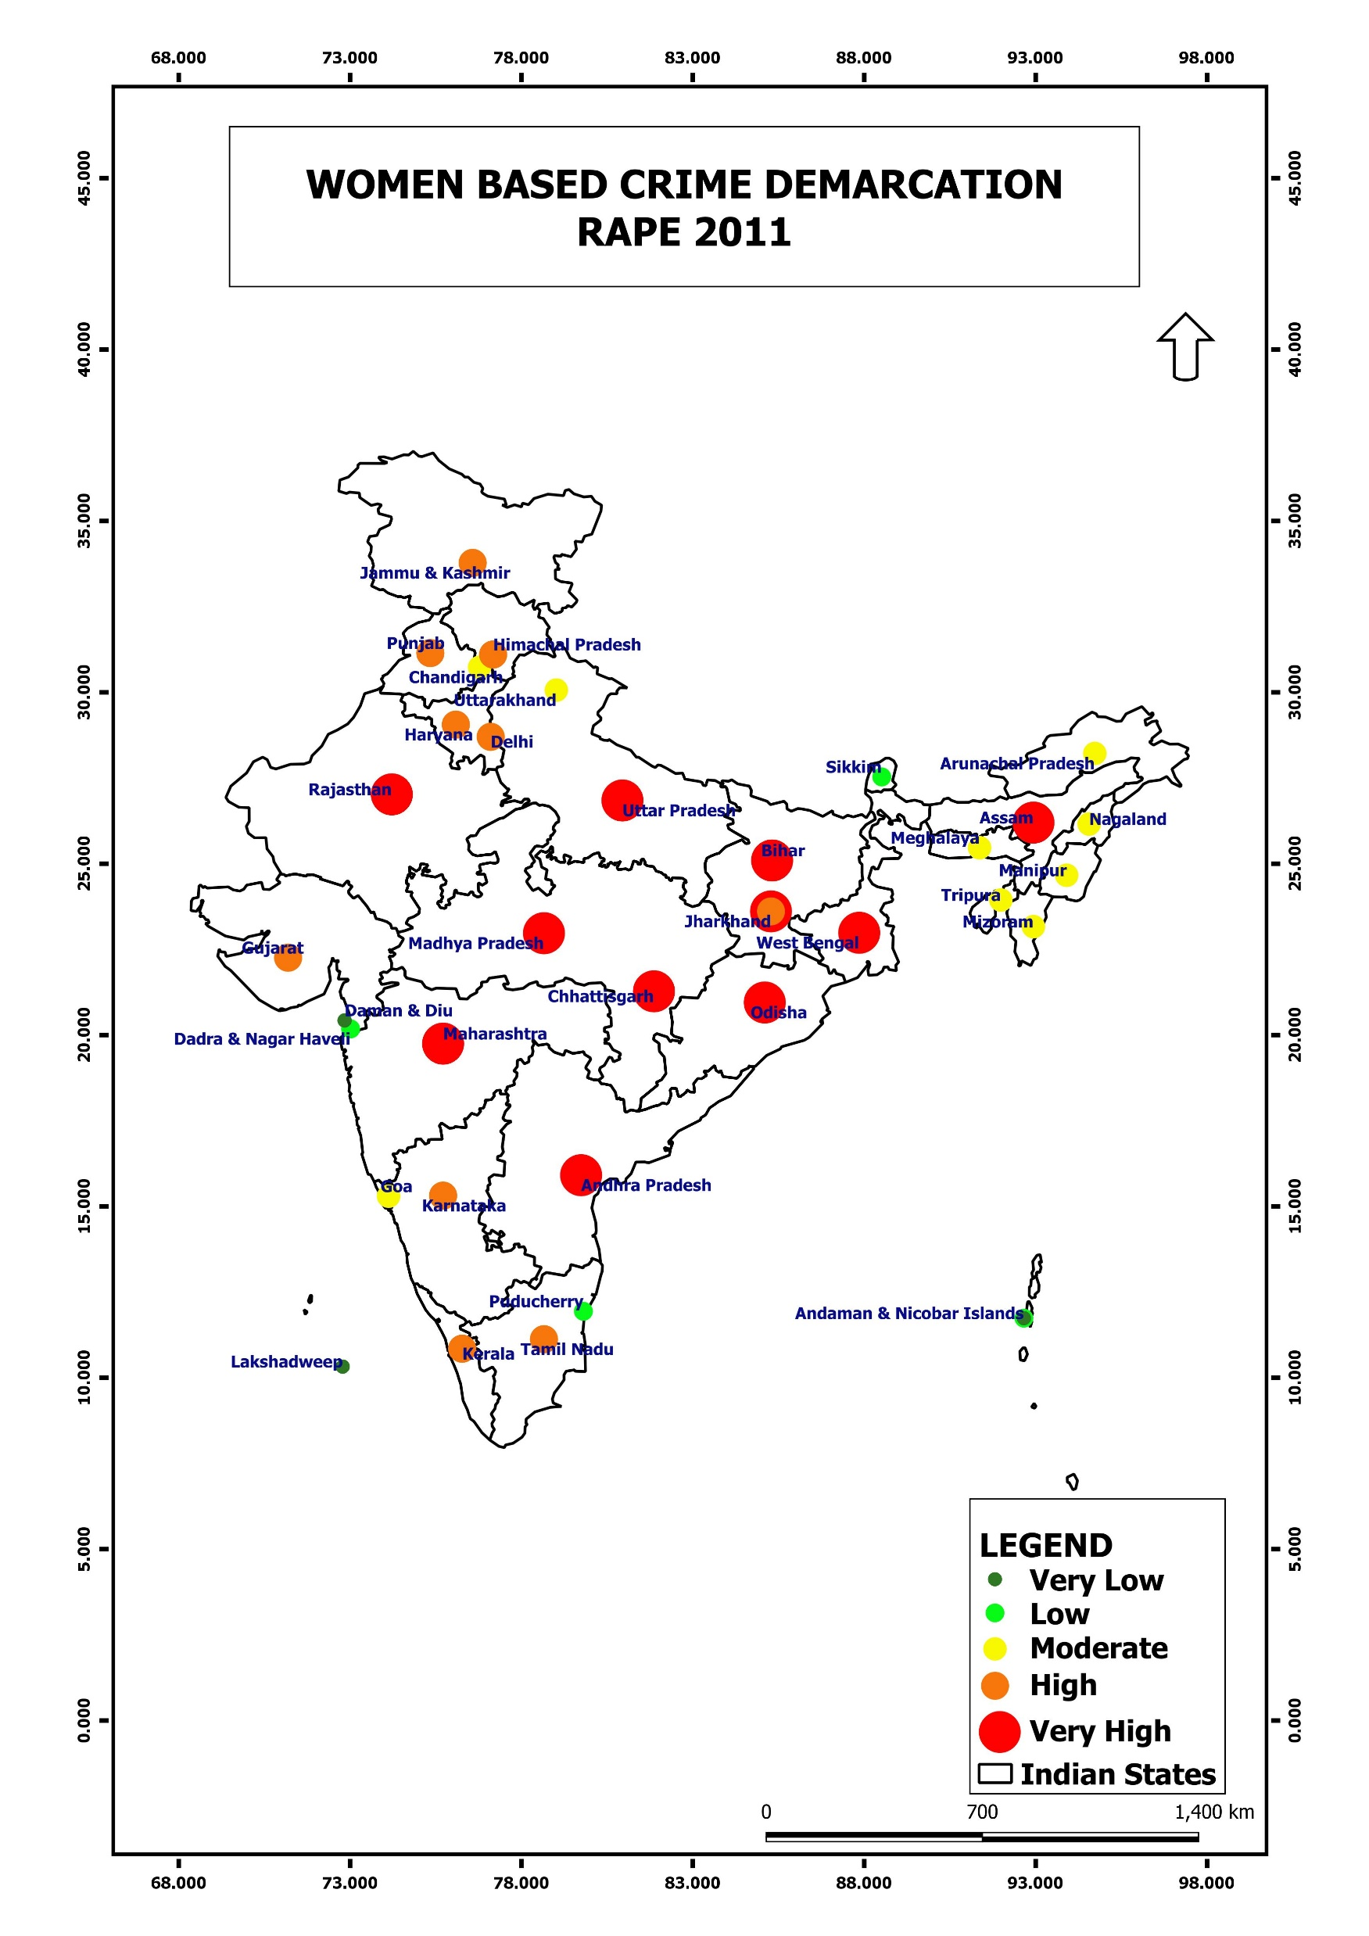
2011
Hotspots
Under Arrest
Introduction
Conclusion
Rape
Bar Chart
Murder
Crimes
About

Slide 6
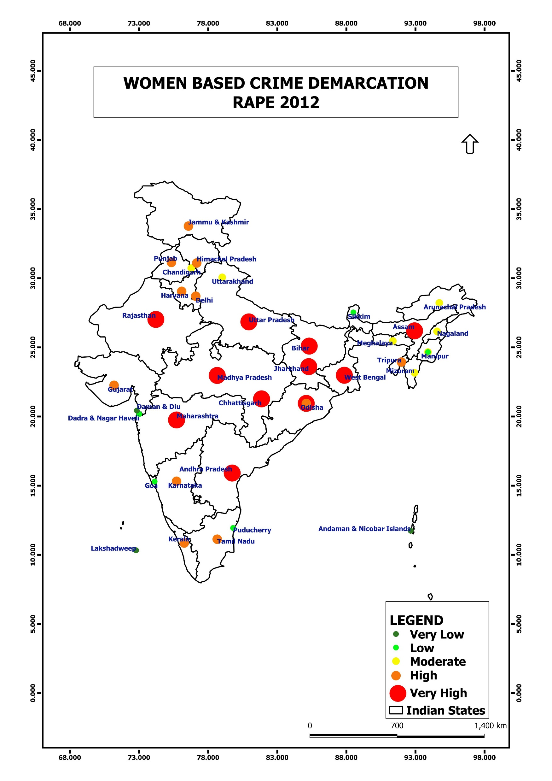
2012
Hotspots
Under Arrest
Introduction
Conclusion
Rape
About
Bar Chart
Murder
Crimes

Slide 7
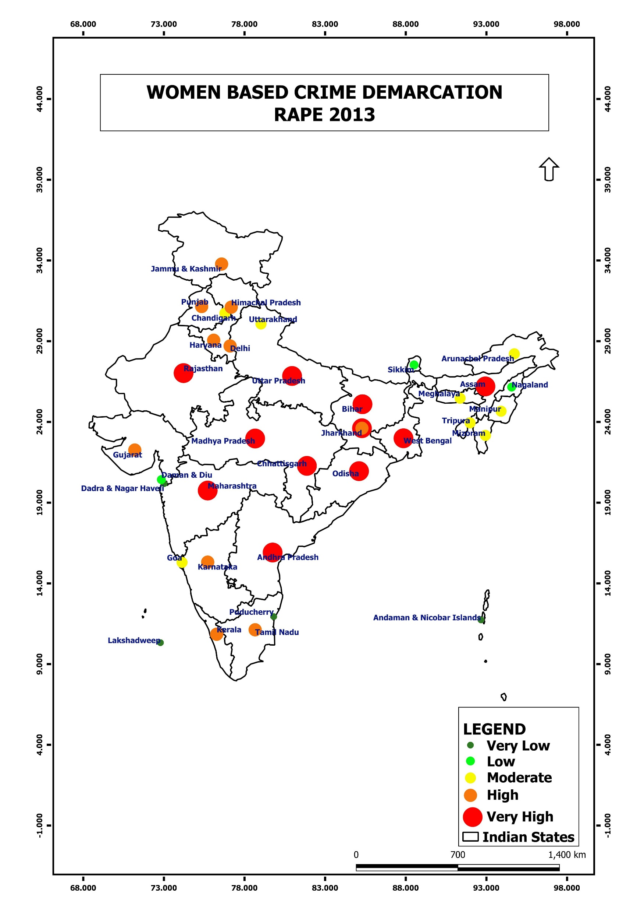
2013
Hotspots
Under Arrest
Introduction
Conclusion
Rape
About
Bar Chart
Murder
Crimes

Slide 8
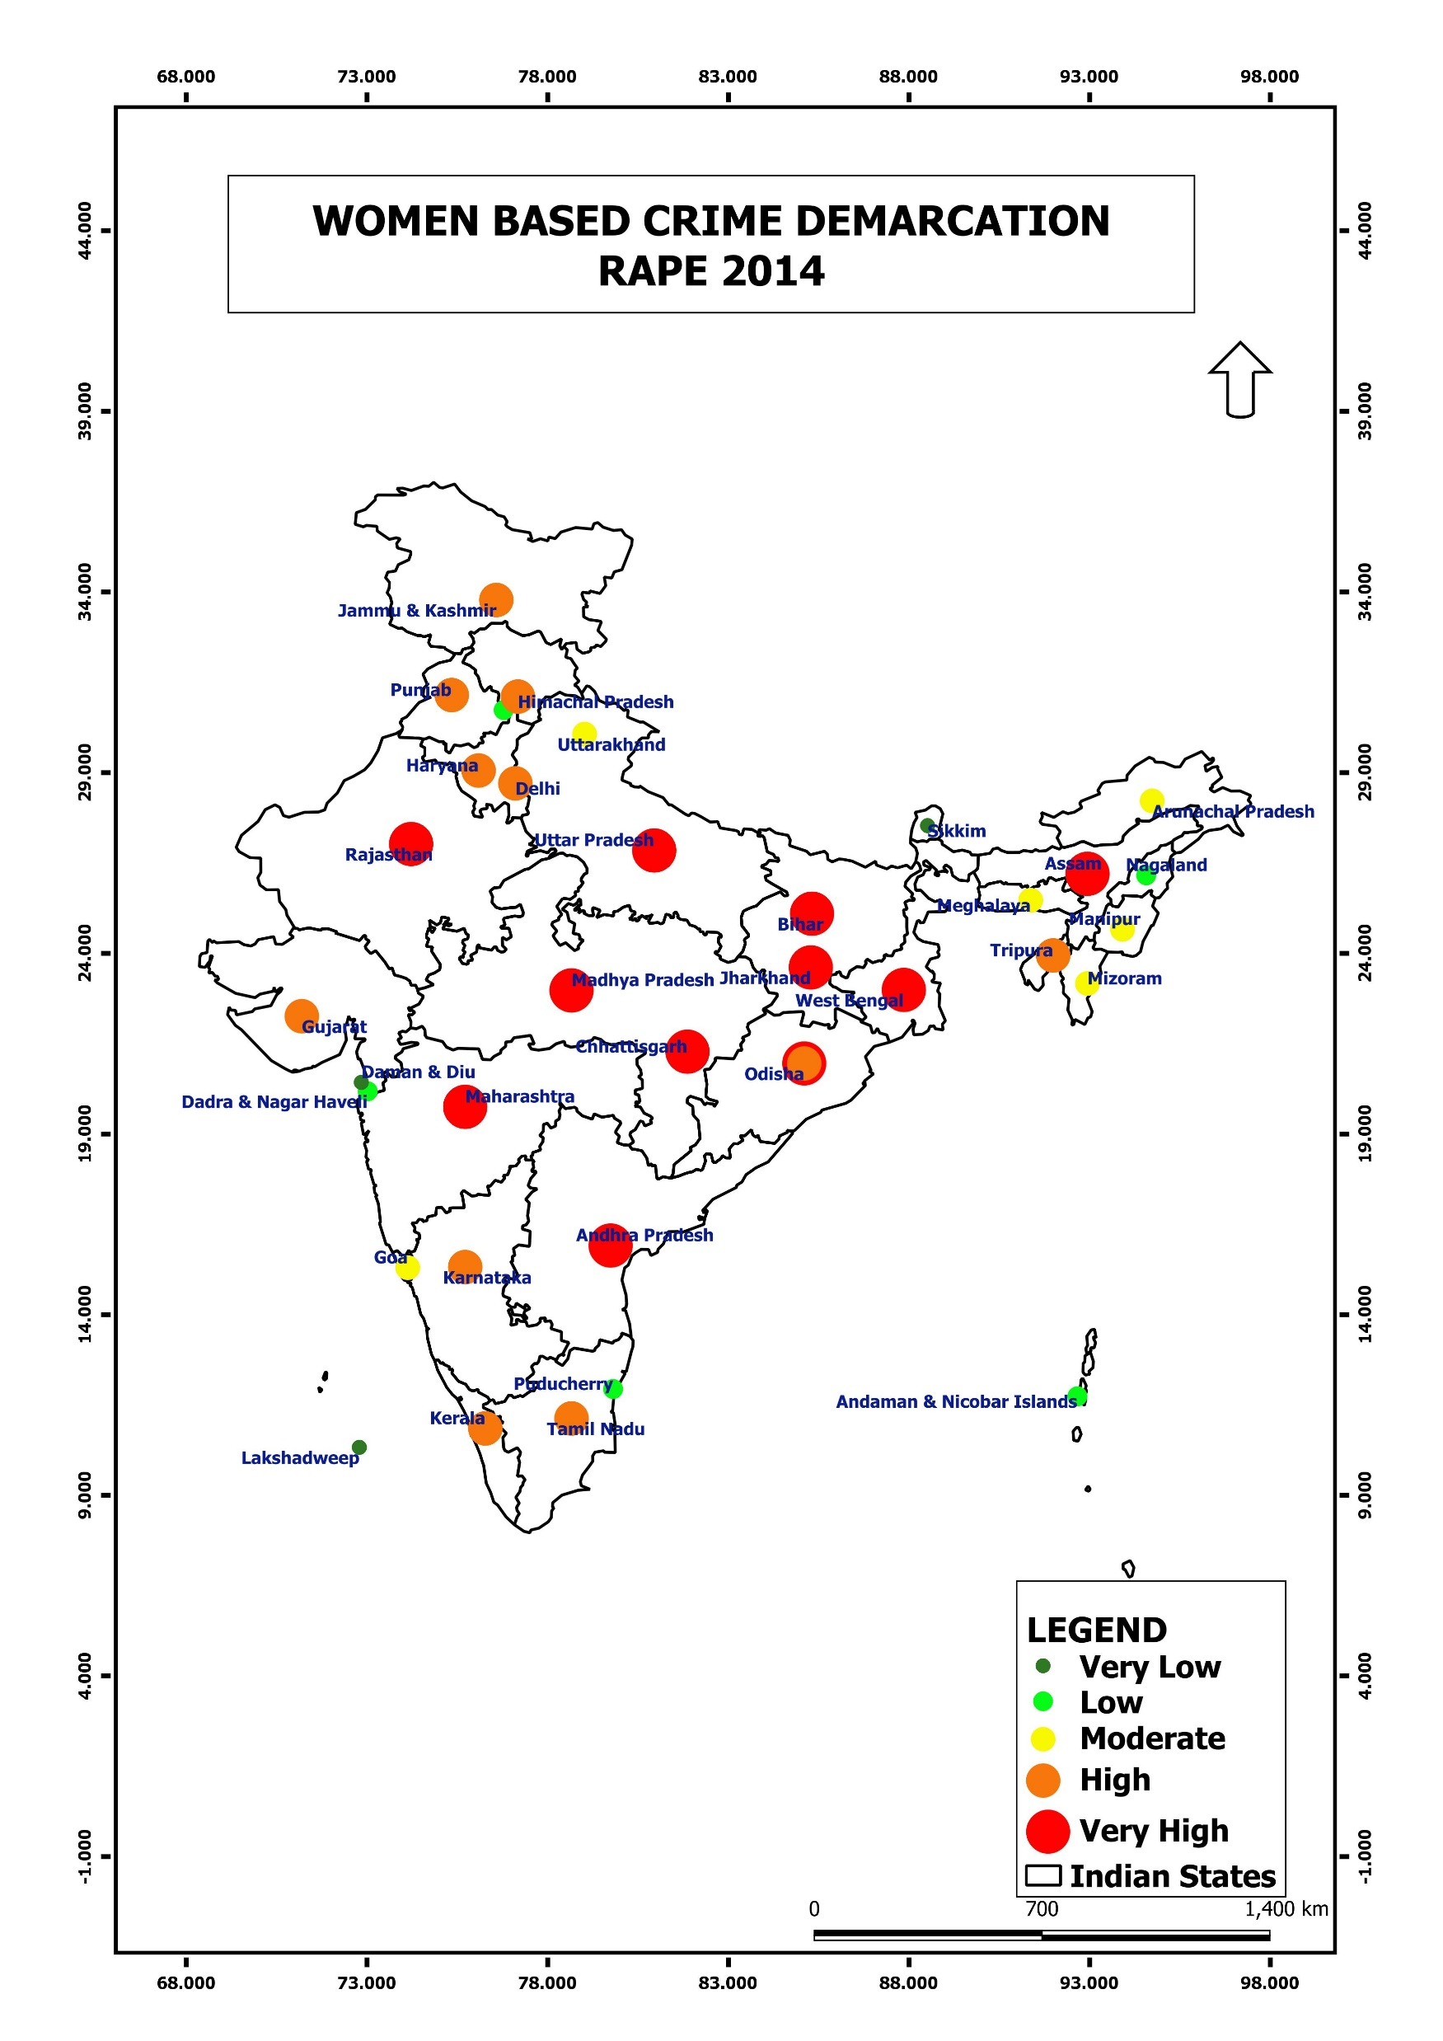
2014
Hotspots
Under Arrest
Introduction
Conclusion
Rape
About
Bar Chart
Murder
Crimes

Slide 9
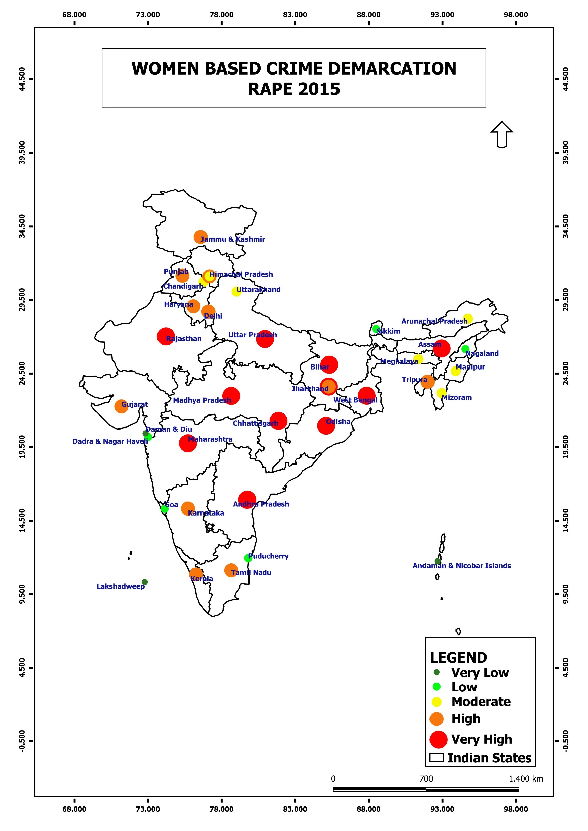
Hotspots
Under Arrest
2015
Introduction
Conclusion
Rape
About
Bar Chart
Murder
Crimes

Slide 10
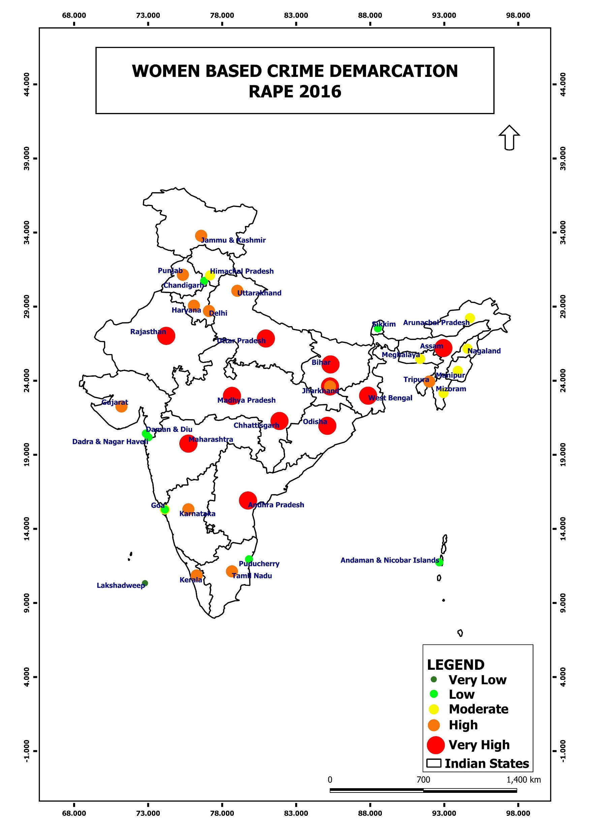
Hotspots
Under Arrest
Introduction
Conclusion
Rape
Bar Chart
Murder
Crimes
About
2016

Slide 11
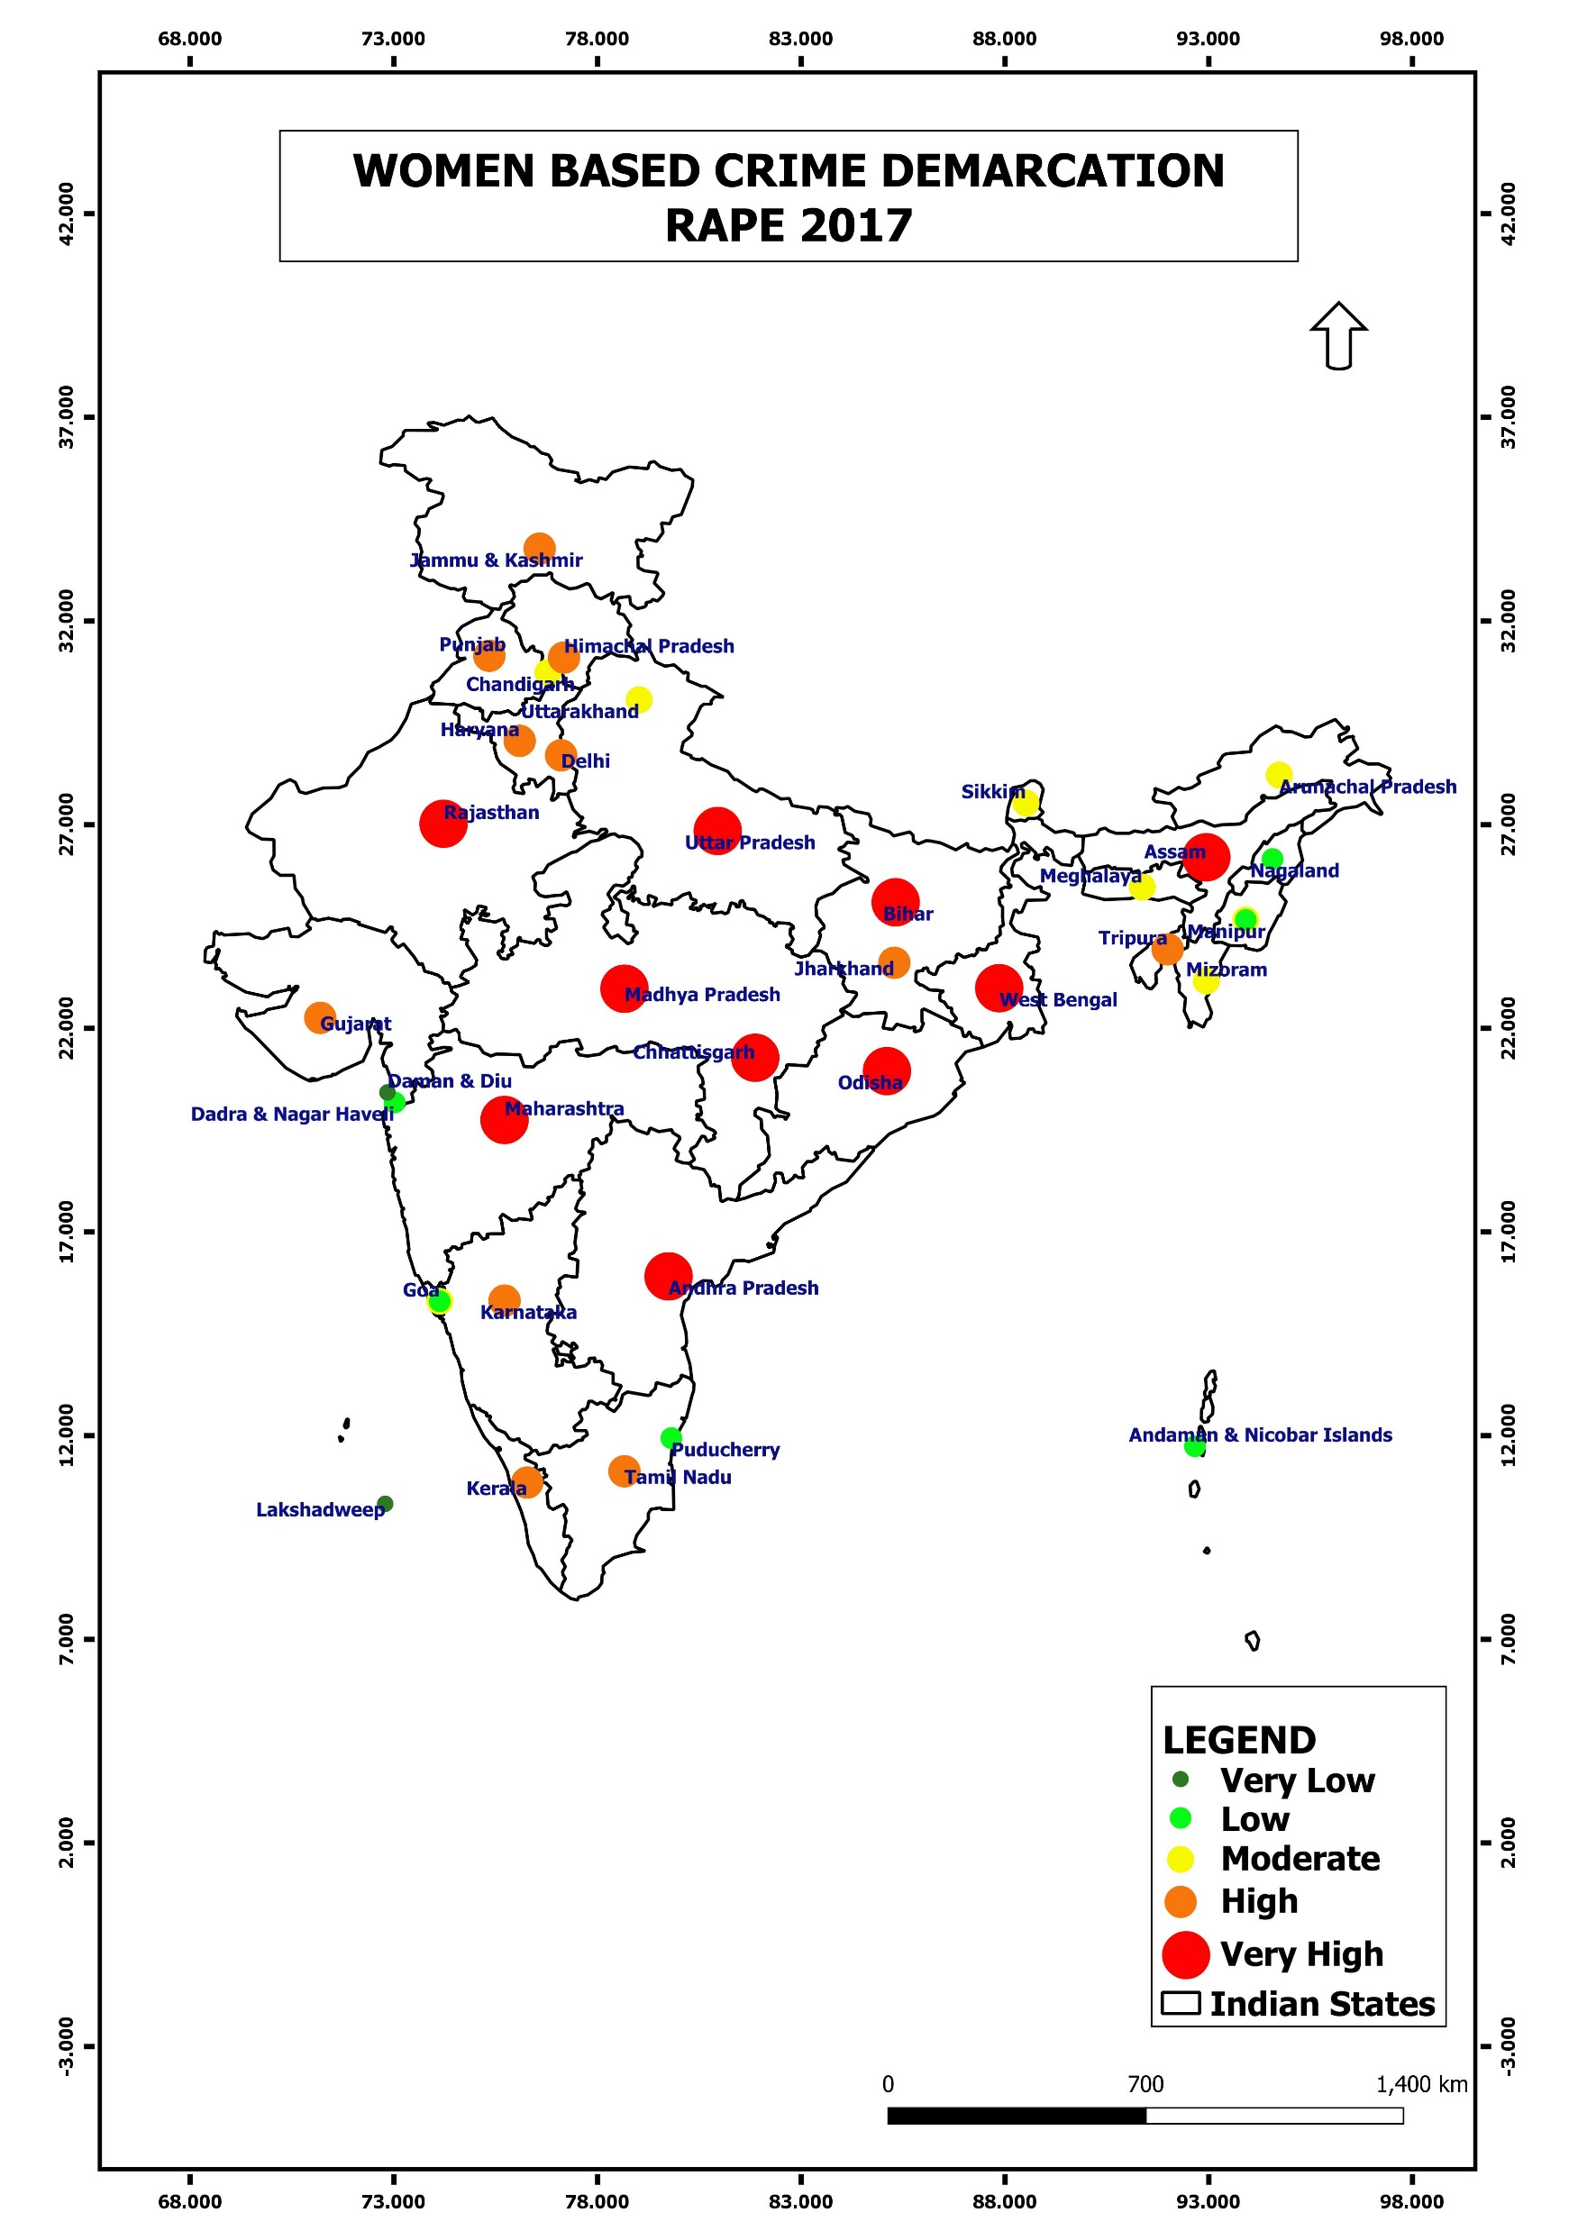
Hotspots
Under Arrest
Introduction
Conclusion
Rape
Bar Chart
Murder
Crimes
About
2017

Slide 12
Hotspots
Under Arrest
Introduction
Conclusion
Rape
Bar Chart
Murder
Crimes
About
2018

Slide 13
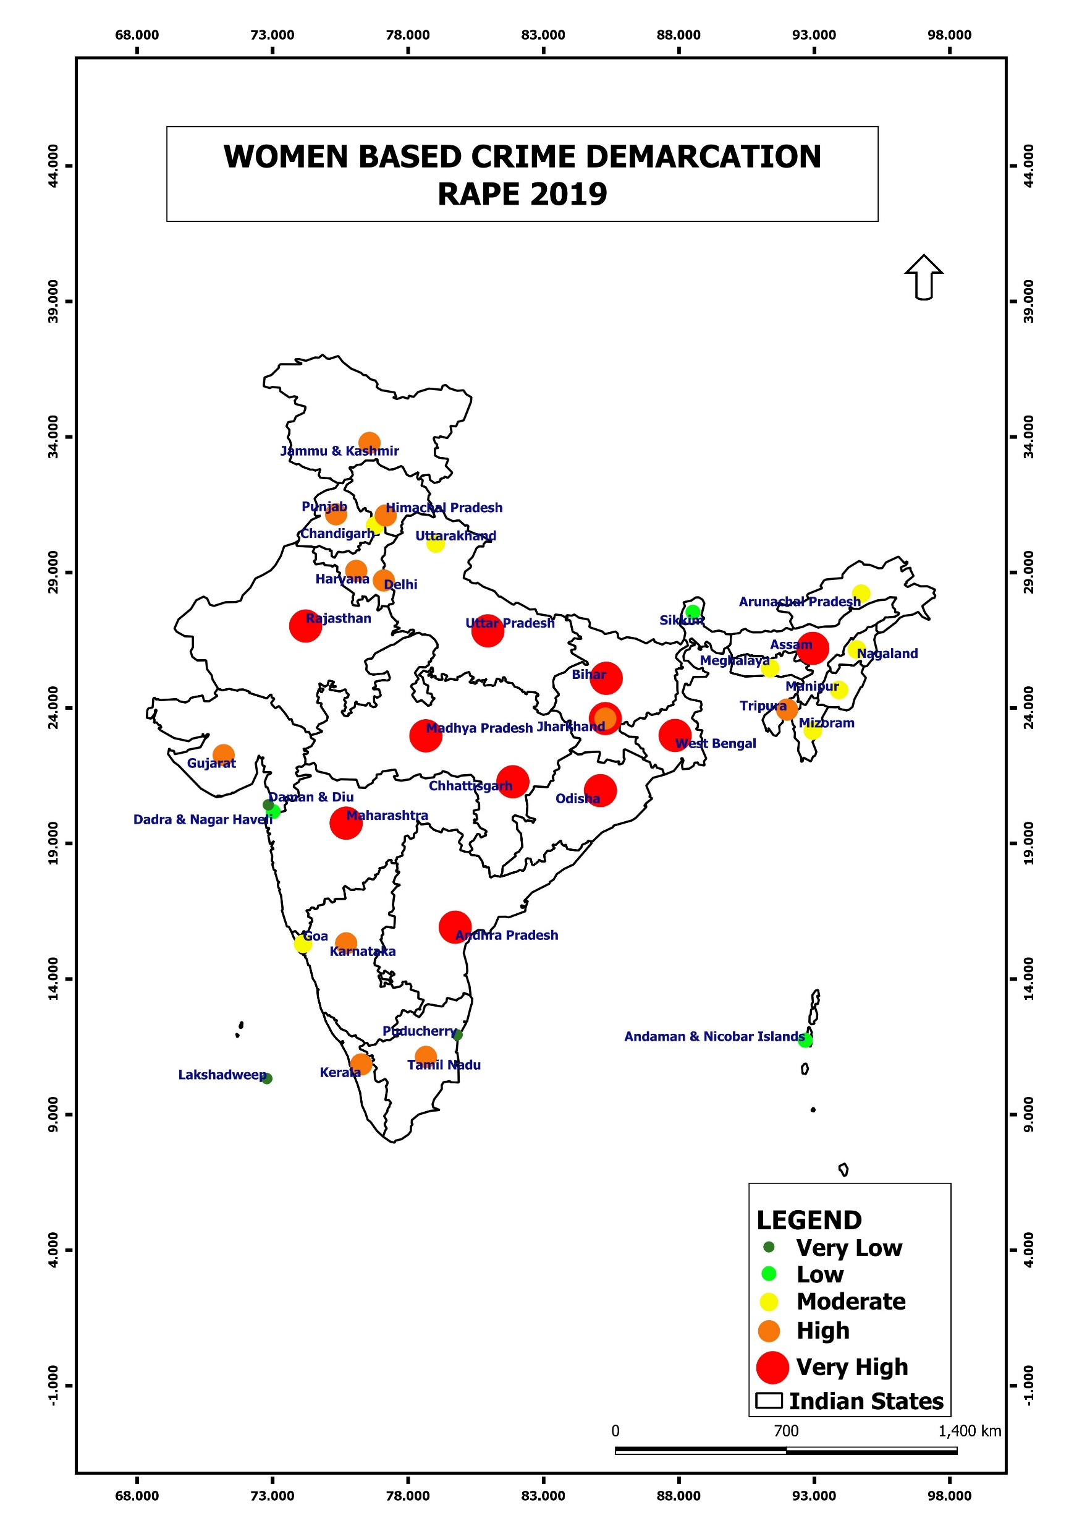
Hotspots
Under Arrest
Introduction
Conclusion
Rape
About
Bar Chart
Murder
Crimes
2019

Slide 14
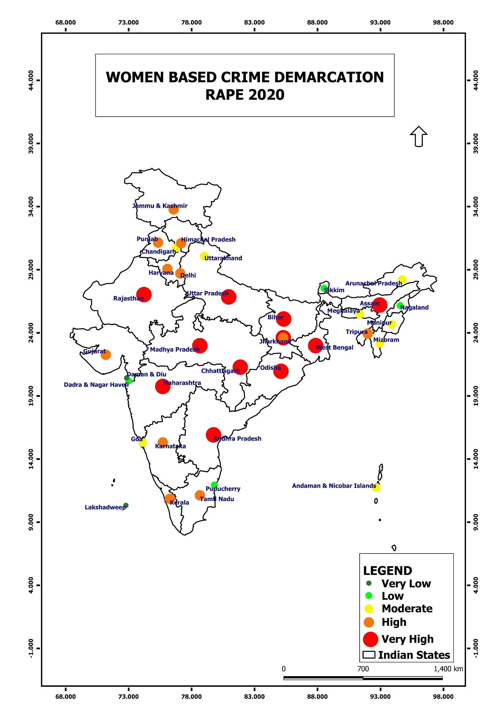
Hotspots
Under Arrest
Introduction
Conclusion
Rape
About
Bar Chart
Murder
Crimes
2020

Slide 15
Hotspots
Under Arrest
Introduction
Conclusion
Rape
About
Bar Chart
Murder
Crimes
2020

Slide 16
Hotspots
Under Arrest
Introduction
Conclusion
Rape
About
Bar Chart
Murder
Crimes

Slide 17
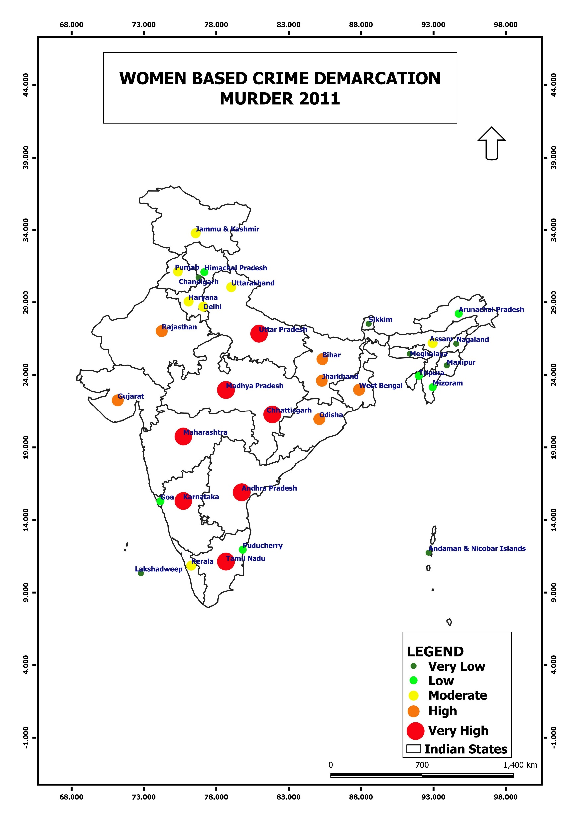
2011
Hotspots
Under Arrest
Introduction
Conclusion
Rape
About
Bar Chart
Murder
Crimes

Slide 18
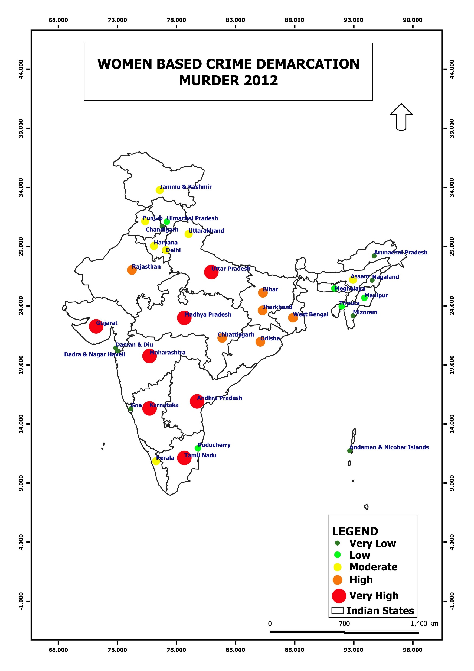
2012
Hotspots
Under Arrest
Introduction
Conclusion
Rape
About
Bar Chart
Murder
Crimes

Slide 19
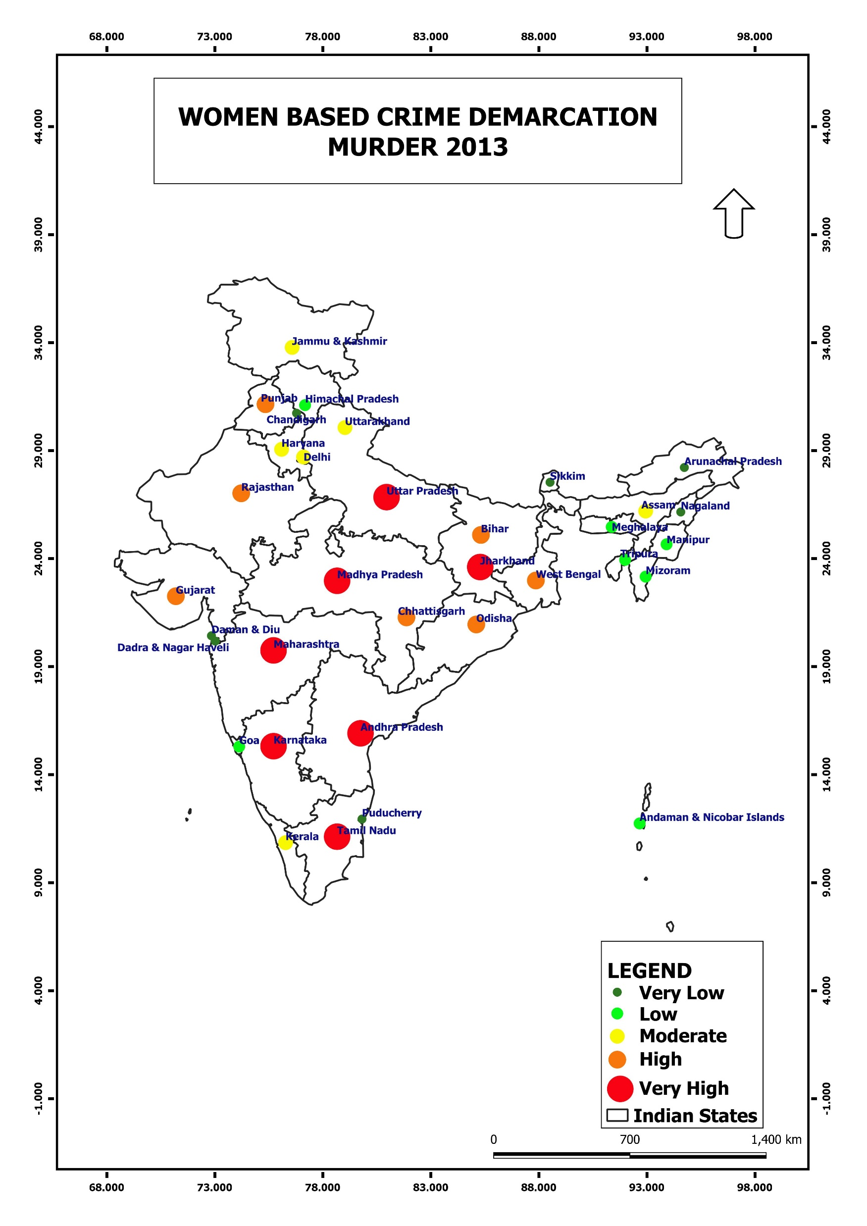
2013
Hotspots
Under Arrest
Introduction
Conclusion
Rape
Bar Chart
Murder
Crimes
About

Slide 20
Hotspots
2014
Under Arrest
Introduction
Conclusion
Rape
About
Bar Chart
Murder
Crimes

Slide 21
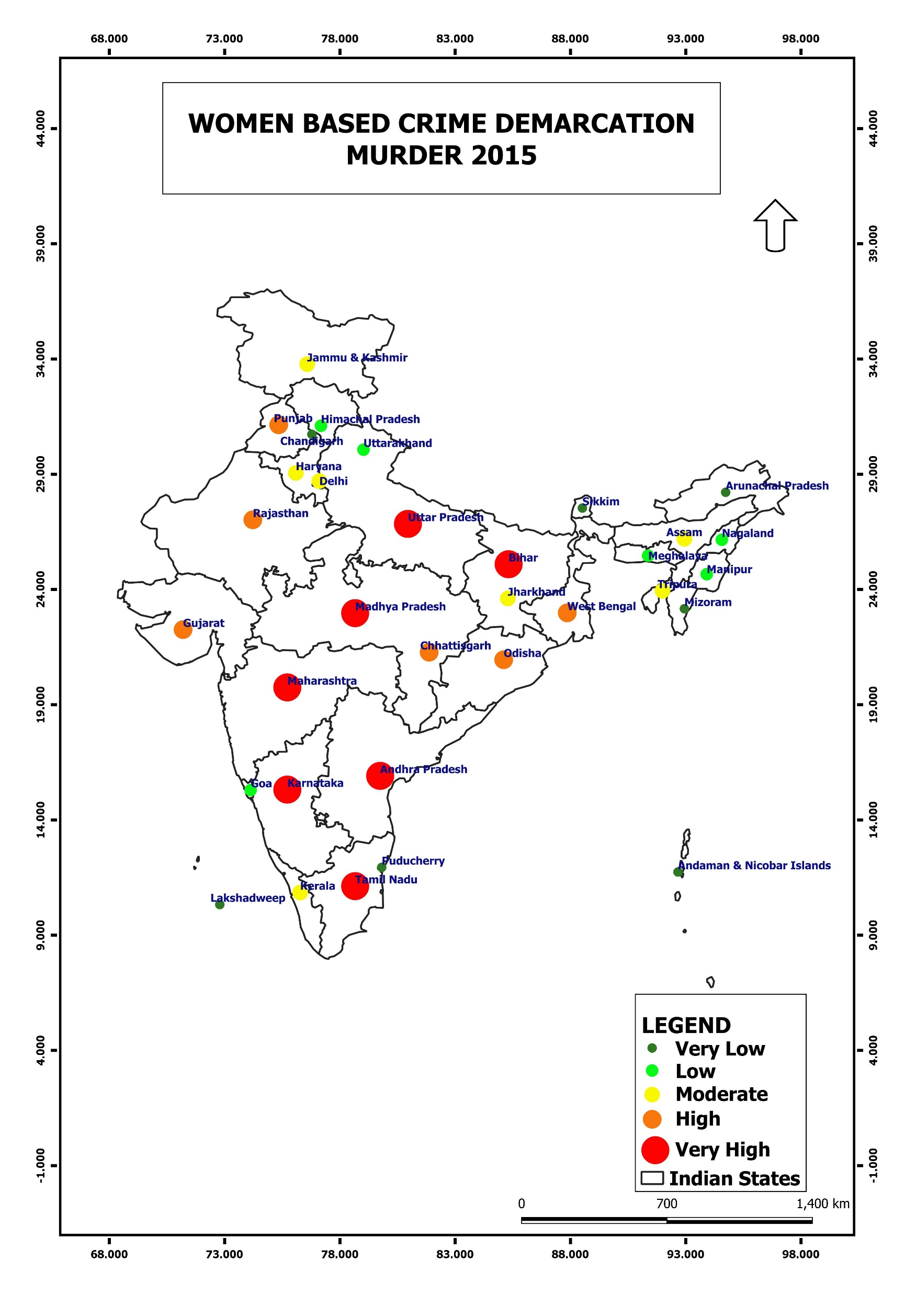
Hotspots
Under Arrest
2015
Introduction
Conclusion
Rape
About
Bar Chart
Murder
Crimes

Slide 22
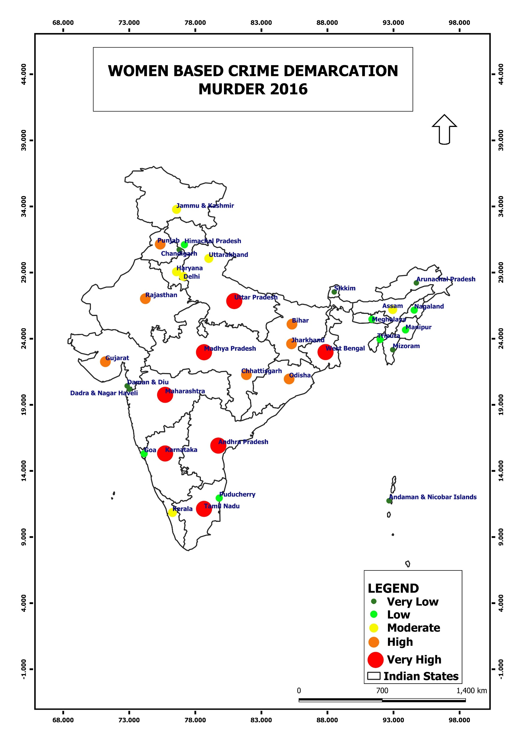
Hotspots
Under Arrest
Introduction
Conclusion
Rape
About
Bar Chart
Murder
Crimes
2016

Slide 23
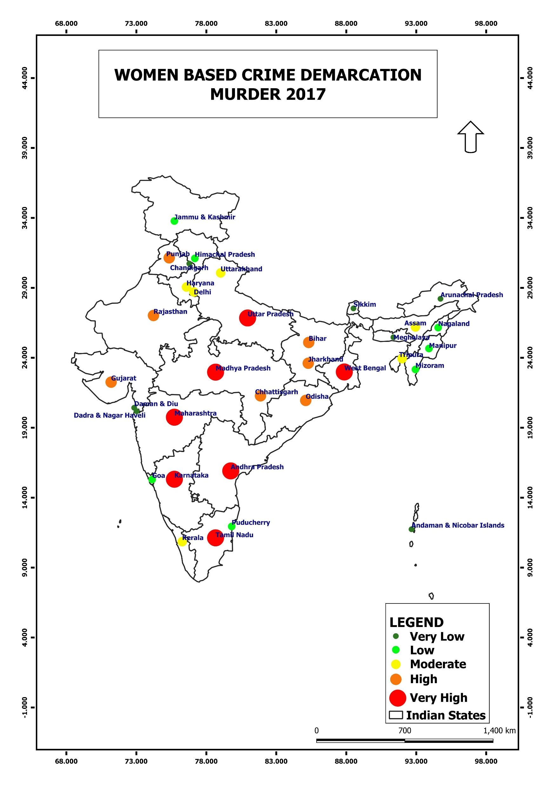
Hotspots
Under Arrest
Introduction
Conclusion
Rape
About
Bar Chart
Murder
Crimes
2017

Slide 24
Hotspots
Under Arrest
Introduction
Conclusion
Rape
About
Bar Chart
Murder
Crimes
2018

Slide 25
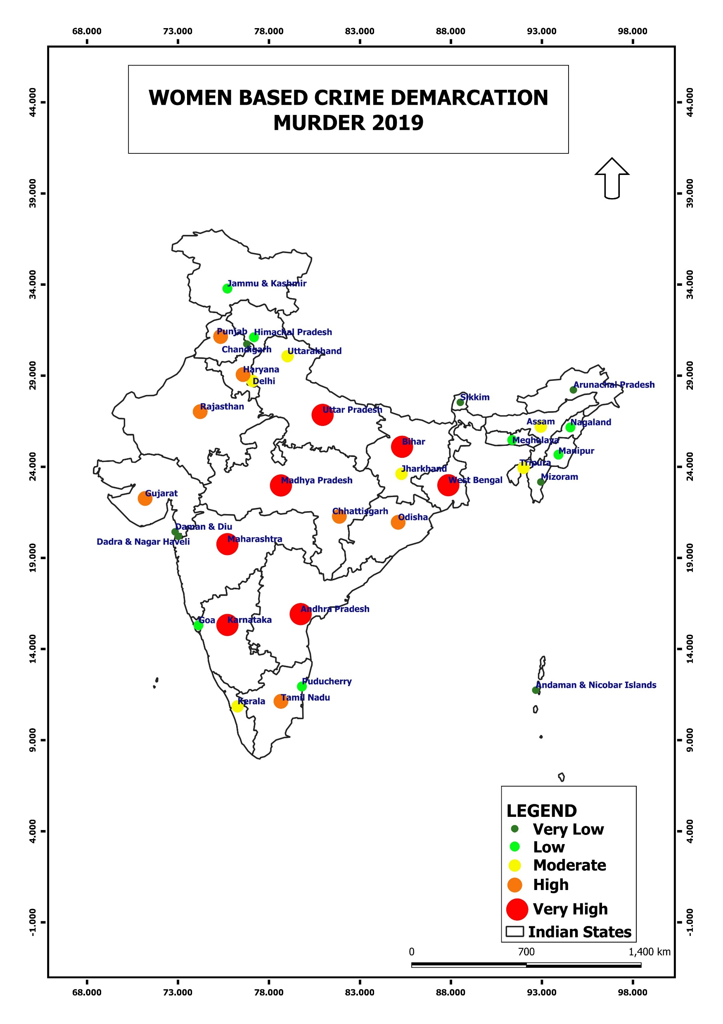
Hotspots
Under Arrest
Introduction
Conclusion
Rape
About
Bar Chart
Murder
Crimes
2019

Slide 26
Hotspots
Under Arrest
Introduction
Conclusion
Rape
About
Bar Chart
Murder
Crimes
2020

Slide 27
Hotspots
Under Arrest
Introduction
Conclusion
Rape
About
Bar Chart
Murder
Crimes
2020

Slide 28
Hotspots
Under Arrest
Introduction
Conclusion
Rape
About
Bar Chart
Murder
Crimes

Slide 29
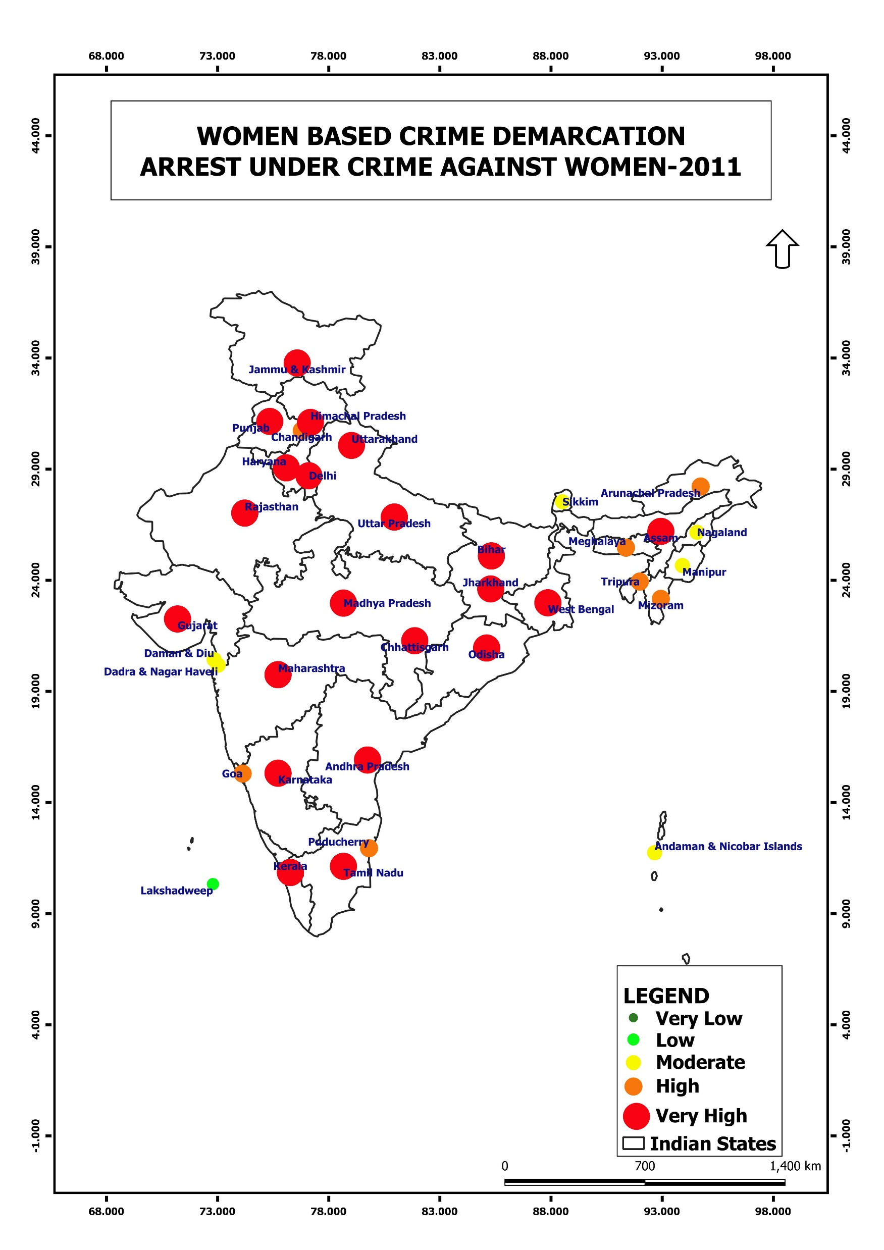
2011
Hotspots
Under Arrest
Introduction
Conclusion
Rape
About
Bar Chart
Murder
Crimes

Slide 30
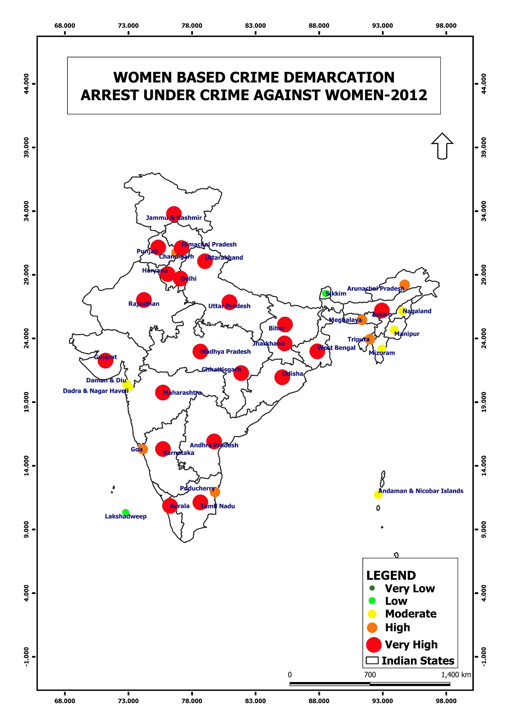
2012
Hotspots
Under Arrest
Introduction
Conclusion
Rape
About
Bar Chart
Murder
Crimes

Slide 31
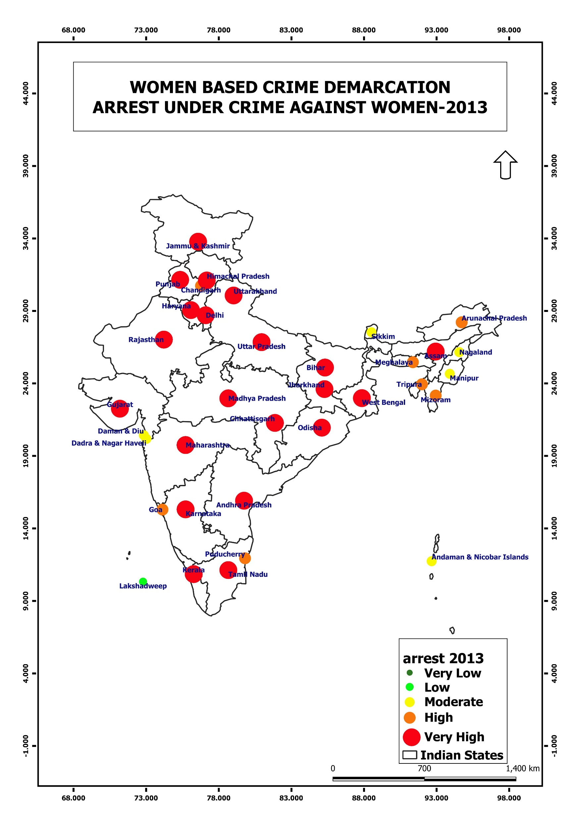
2013
Hotspots
Under Arrest
Introduction
Conclusion
Rape
Bar Chart
Murder
Crimes
About

Slide 32
2014
Hotspots
Under Arrest
Introduction
Conclusion
Rape
About
Bar Chart
Murder
Crimes

Slide 33
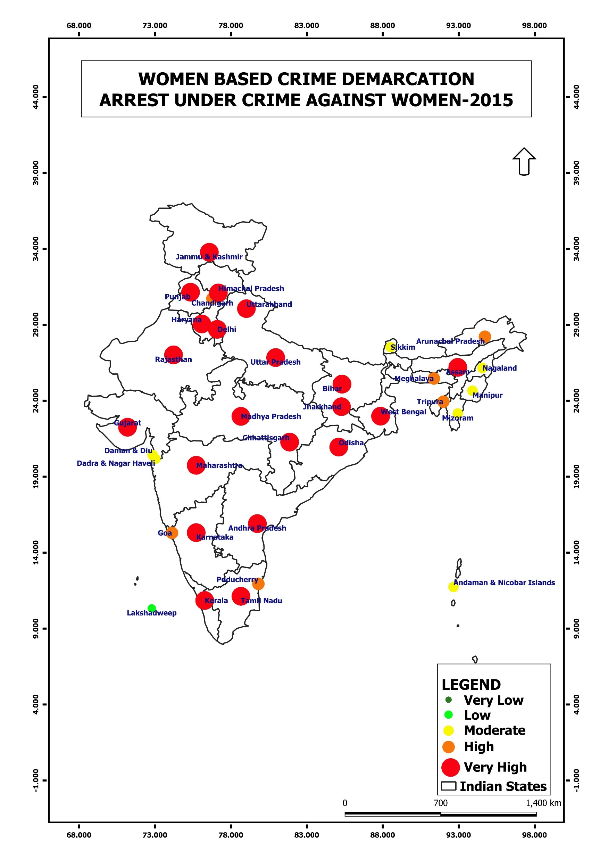
Hotspots
Under Arrest
Introduction
Conclusion
2015
Rape
About
Bar Chart
Murder
Crimes

Slide 34
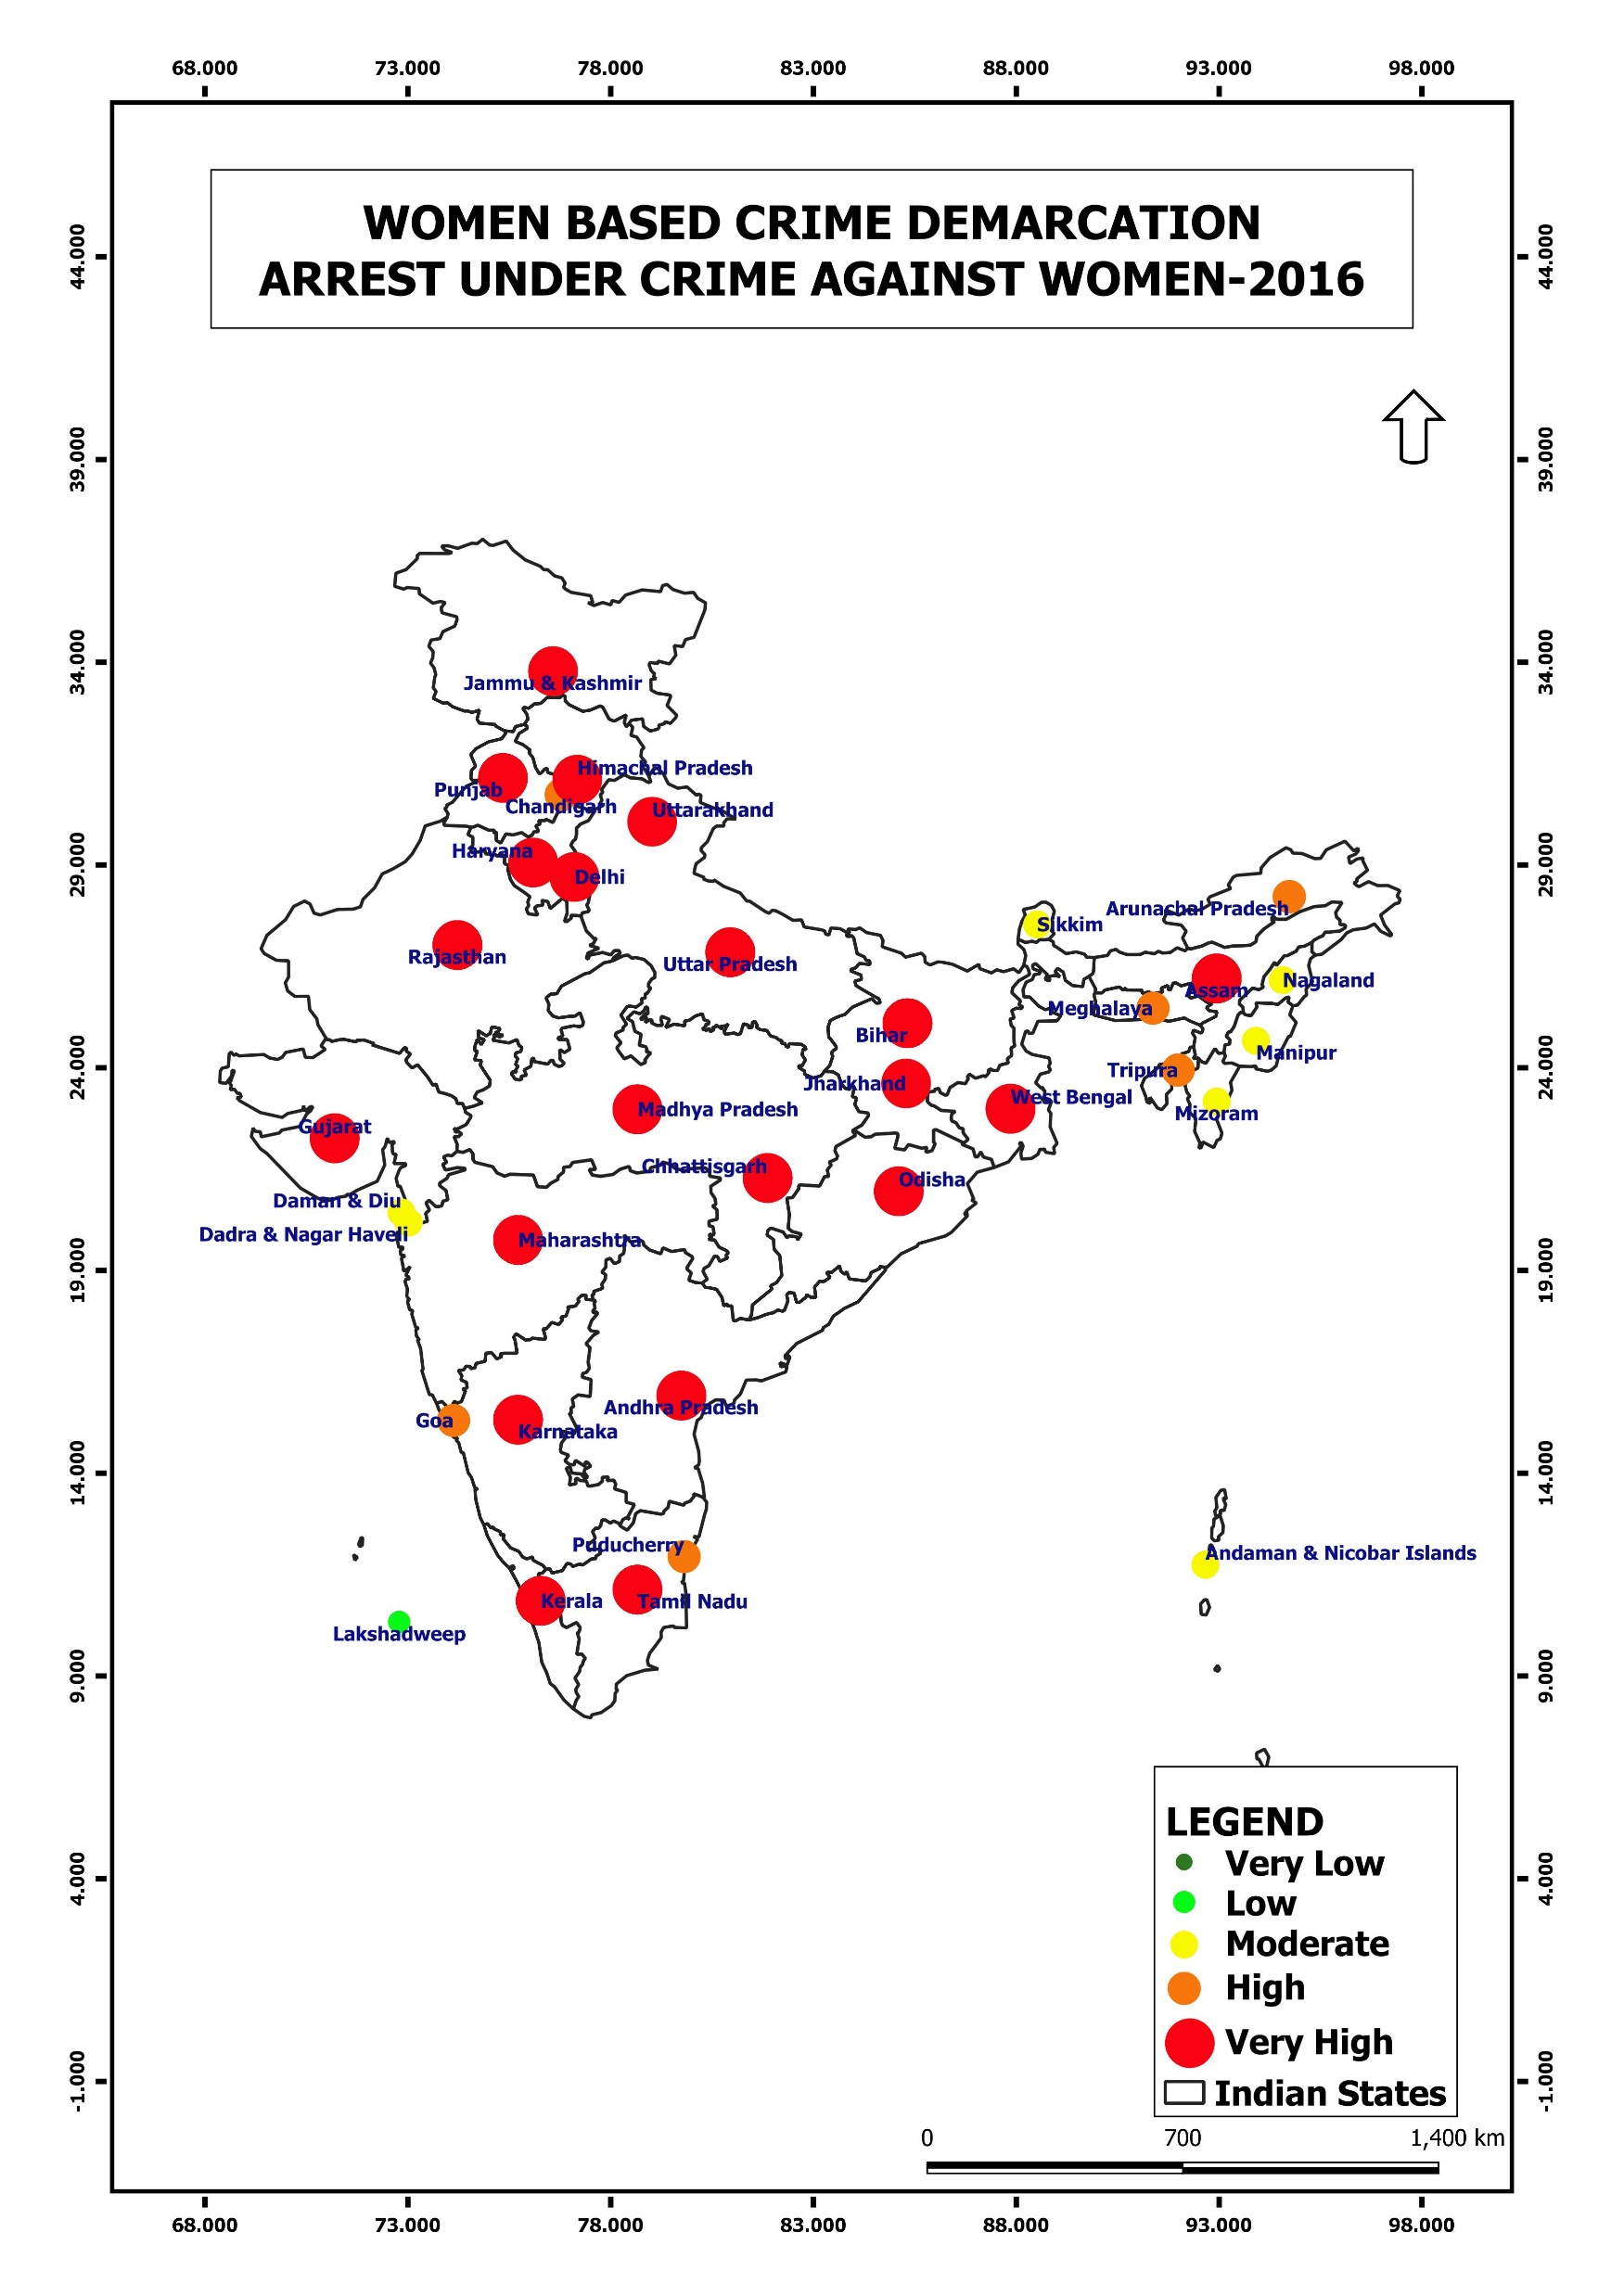
Hotspots
Under Arrest
Introduction
Conclusion
Rape
About
Bar Chart
Murder
Crimes
2016

Slide 35
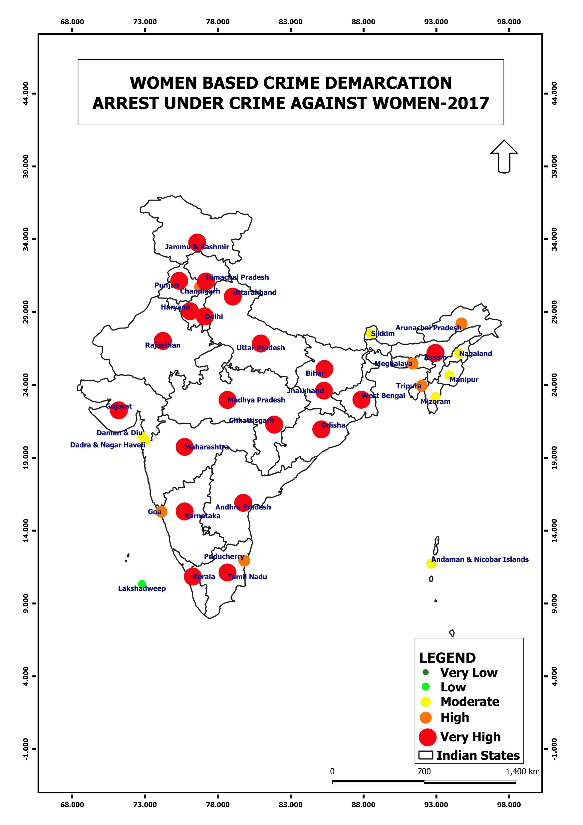
Hotspots
Under Arrest
Introduction
Conclusion
Rape
About
Bar Chart
Murder
Crimes
2017

Slide 36
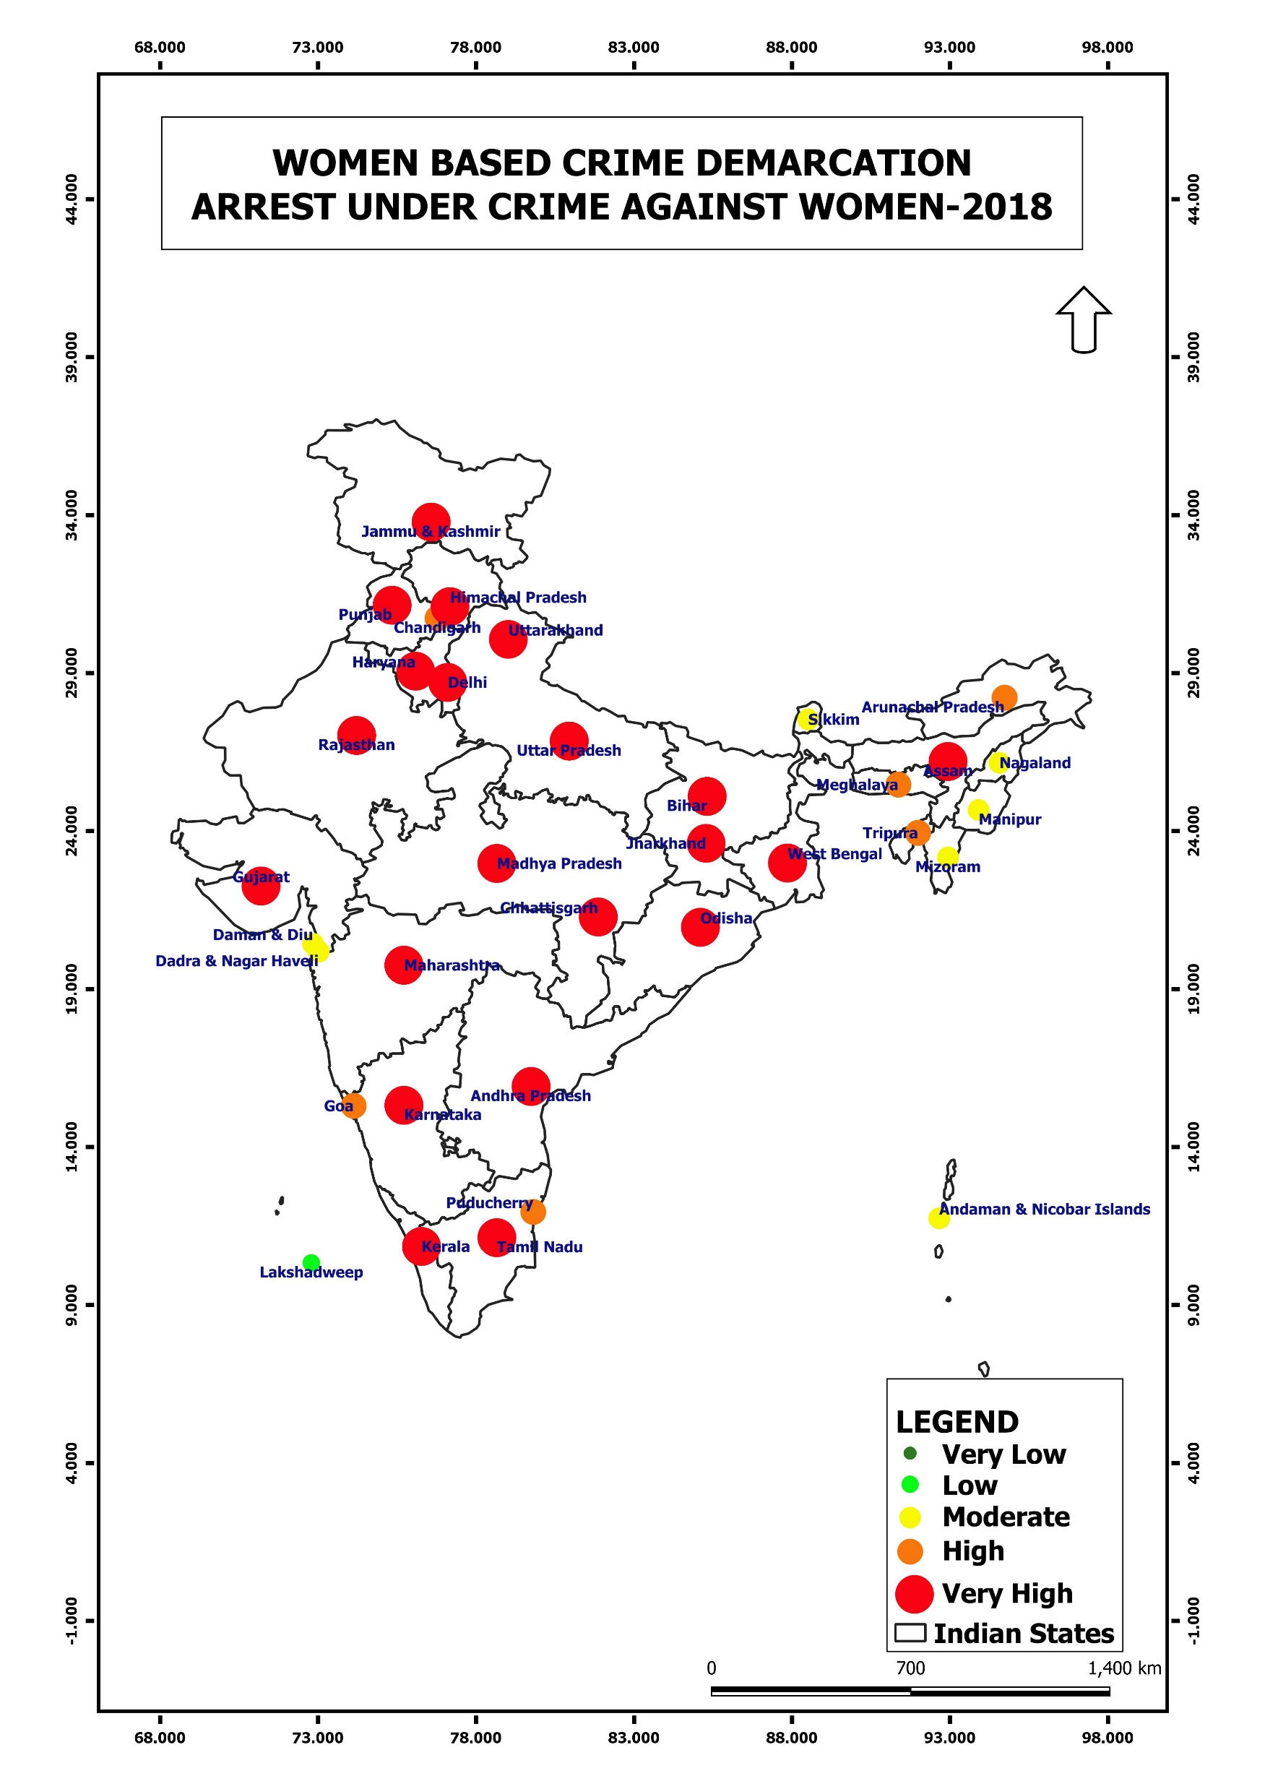
Hotspots
Under Arrest
Introduction
Conclusion
Rape
About
Bar Chart
Murder
Crimes
2018

Slide 37
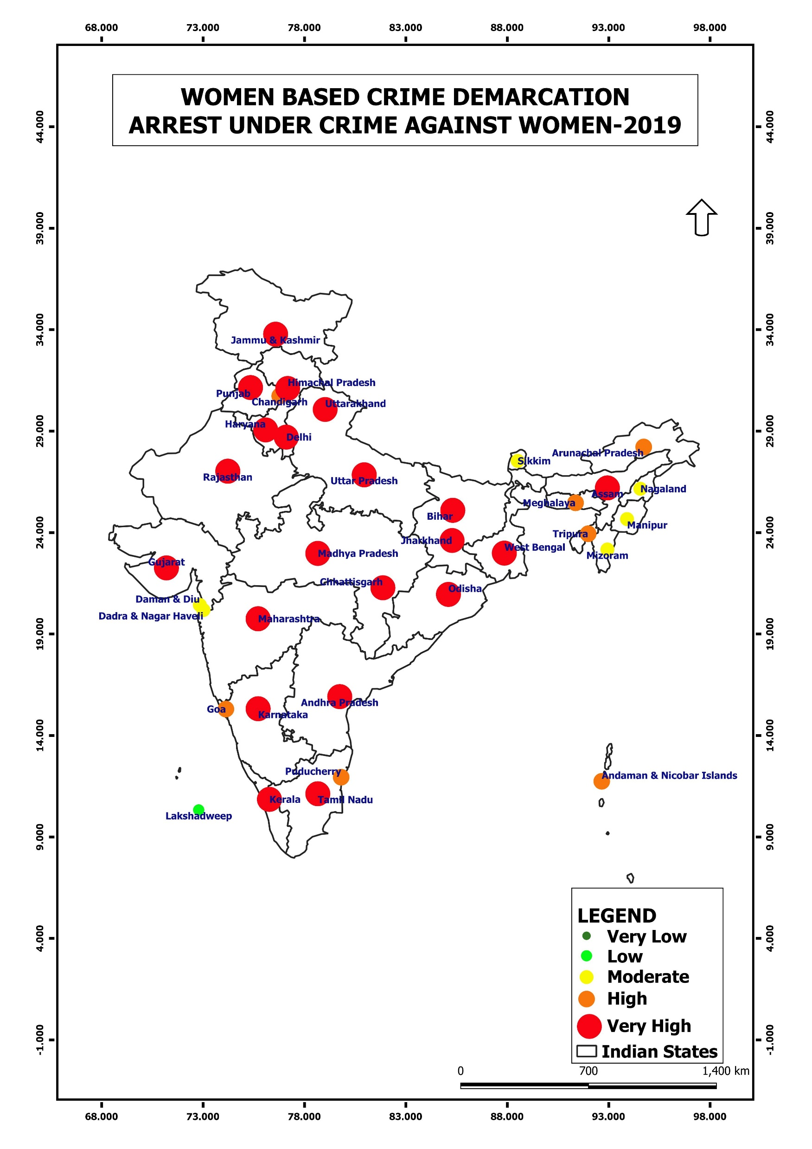
Hotspots
Under Arrest
Introduction
Conclusion
Rape
About
Bar Chart
Murder
Crimes
2019

Slide 38
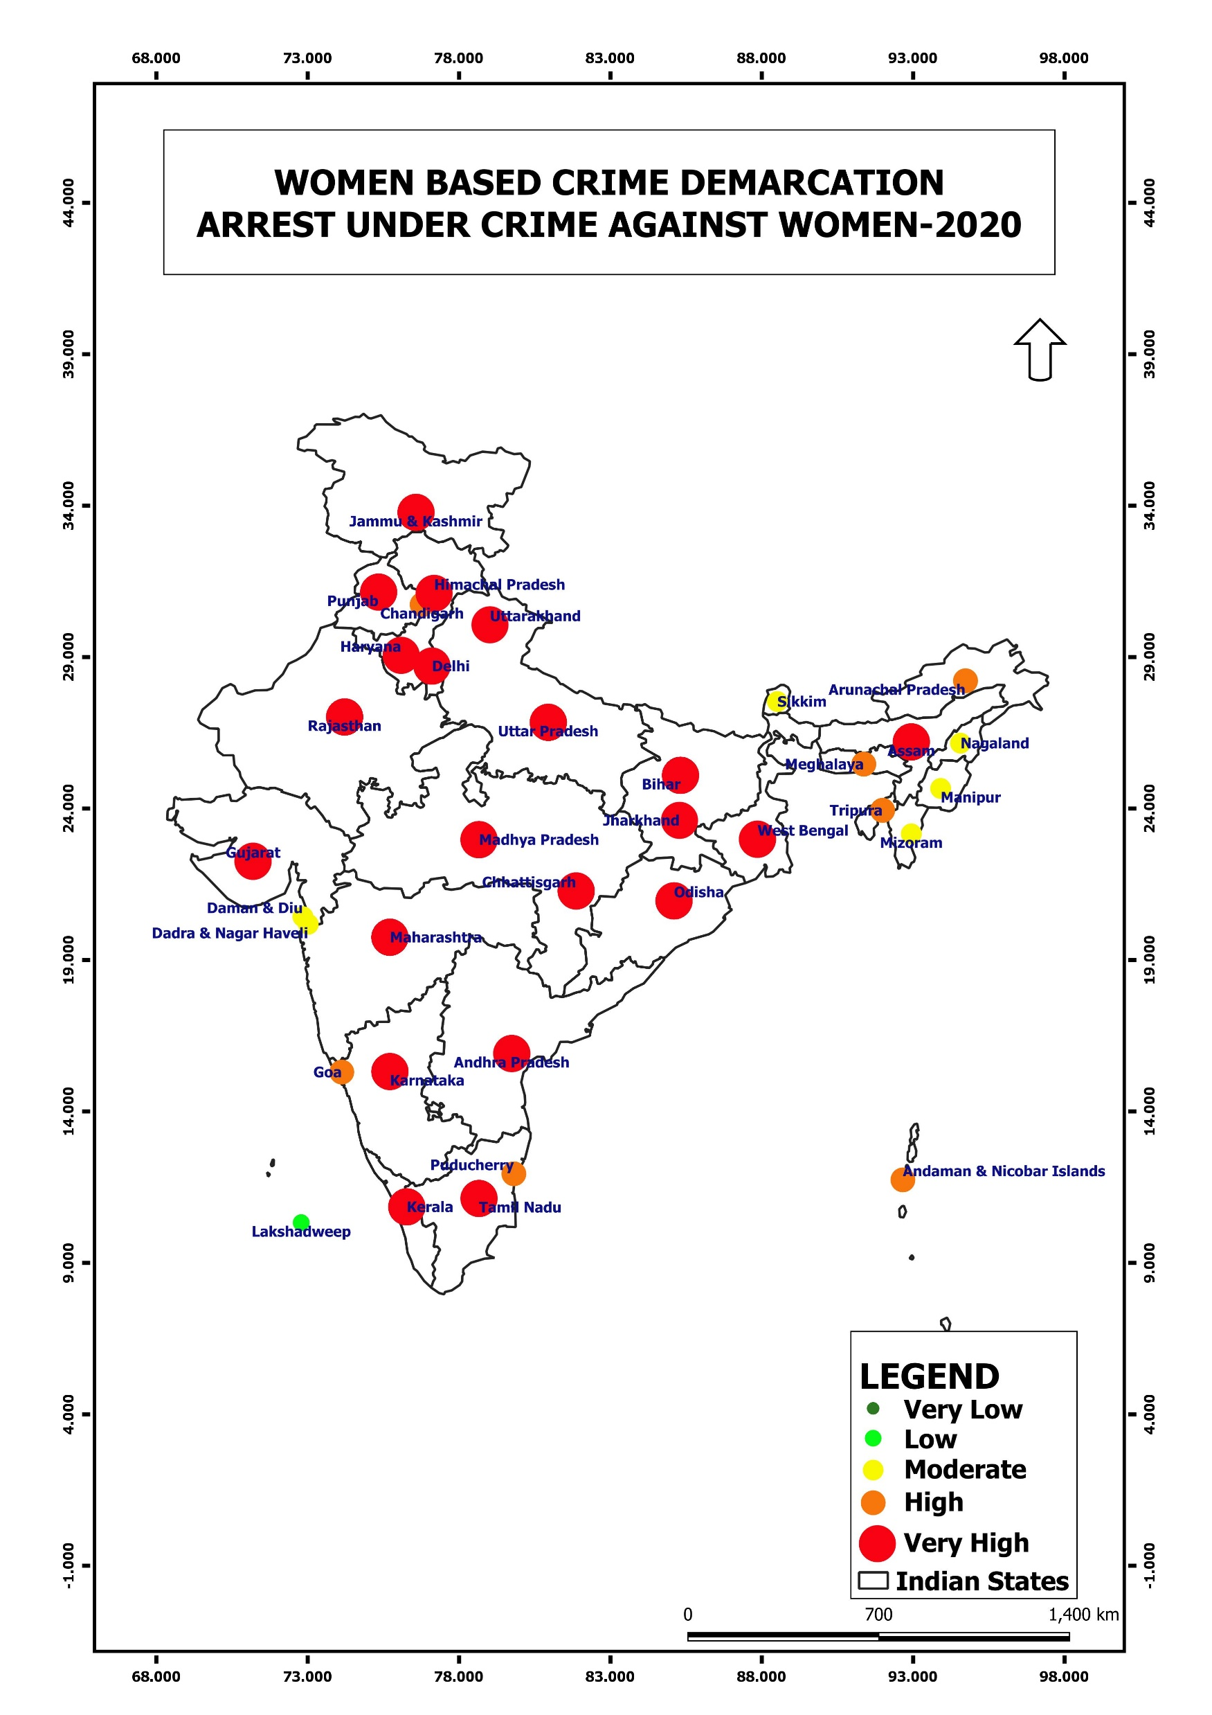
Hotspots
Under Arrest
Introduction
Conclusion
Rape
Bar Chart
Murder
Crimes
About
2020

Slide 39
Hotspots
Under Arrest
Introduction
Conclusion
Rape
Bar Chart
Murder
Crimes
About
2020

Slide 40
Hotspots
Under Arrest
Introduction
Conclusion
Rape
Bar Chart
Murder
Crimes
About

Slide 41
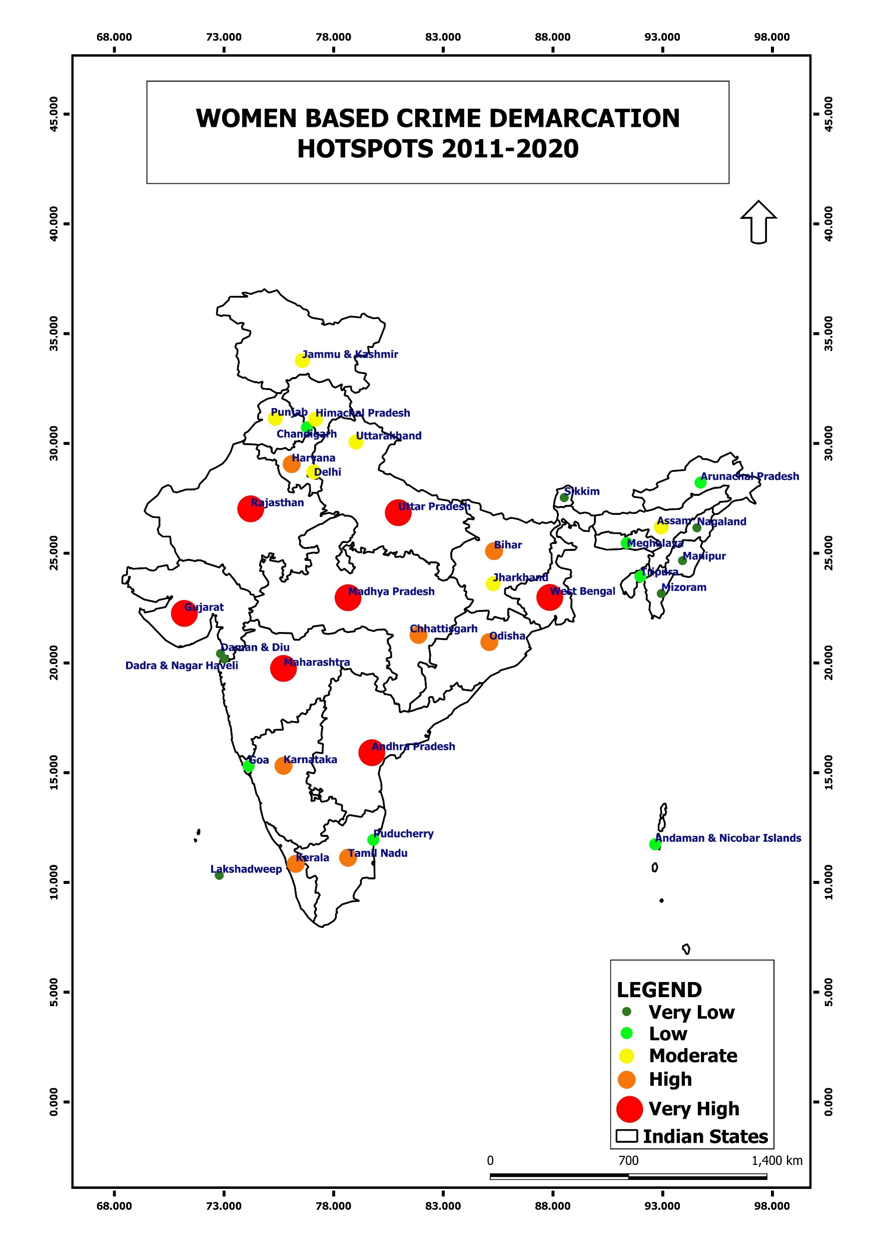
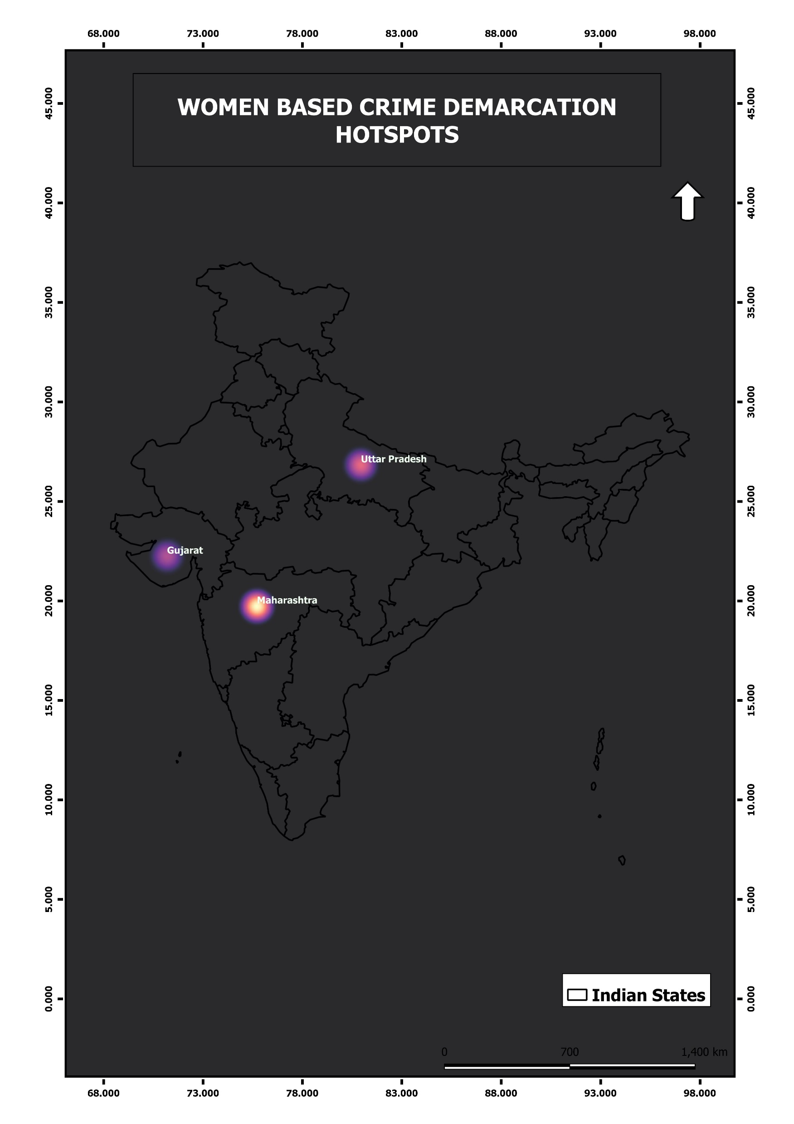
Hotspots
Under Arrest
Introduction
Conclusion
Rape
Bar Chart
Murder
Crimes
About

Slide 42
Hotspots
Introduction
Conclusion
Bar Chart
Rape
Under Arrest
About
Murder
Crimes

Slide 43
This potent technology used in the current study for mapping the crime and its dark hotspot region for women-based crimes in entire Indian subcontinent and to identify crime prone zones through crime mapping with probability of occurrence based on the past incidence of various crime locations.
It provides spatial crime hot spots so as police can plan better surveillance plan and scheduling so as to minimize crime incidences.
With the help of GIS, aiming for better India in 2050
Hotspots
Conclusion
Introduction
Bar Chart
Rape
Under Arrest
About
Murder
Crimes

